Slide 1
TEACHING FOR MASTERY IN FE
Course introduction

Slide 2
Centres for Excellence in Mathematics (CfEM)
  Teaching for Mastery in FE draws on the work of the 21 CfEM colleges and their networks
  Presents a vision of how mastery teaching in schools can be transferred to FE colleges to meet the needs of learners working towards level 2 maths
  It is based on five key principles drawn up following a series of consultations with the 21 CfEM colleges in spring 2019.

Slide 3
Five Key Principles for FE
Prioritises curriculum coherence and connections
Values and builds on students’ prior learning
Develops an understanding of mathematical structure of key concepts
Teaching for Mastery
Develops a collaborative culture in which everyone believes everyone can succeed
Develops both fluency and understanding of key ideas
Notes:
Explain that these are the 5 key principles of mastery that were adopted by CfEM and informed its activities. They were agreed early in the programme by the 21 colleges involved.
How much do you focus on the 5 key principles in your establishment?
Encourage reflection on these throughout the session
They also inform the body of what will be introduced & discussed.

Slide 4
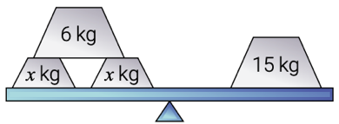
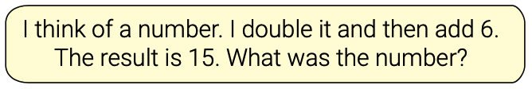


Key principle 1: Teaching that allows students to develop an understanding of mathematical structure
  Using representations to unlock understanding, so students know the ‘why’ and not just the ‘how’.
  Look at the four representations on the right. Can you see how they share the same underlying structure and solutions?
  Key element of teaching for mastery is the concrete, pictorial, abstract (CPA) approach. Learners:
    start with physical manipulatives
    move on to pictorial representations
    and finally to abstract symbols.

Slide 5

Key principle 2: Valuing and building on students’ prior learning
  FE learners have prior knowledge from which to build – celebrating what learners know can be motivating.
  Learners also have many gaps in their knowledge and misconceptions which need to be addressed.
  This requires on-going formative assessment – which we have termed responsive teaching.
  Drawing on the thinking of peers is an important part of this process.

Slide 6

Key principle 3: Prioritising curriculum coherence and connections
  Key issue is limited time to cover content of GCSE re-sit.
  Teachers need to decide what to cover and in what depth.
  Learners need to have insight into mathematical ideas and make connections between maths topics.
  Links across maths topics need to be made explicit.

Slide 7
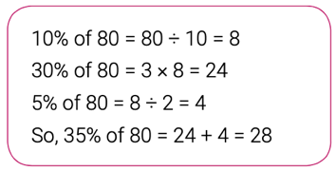
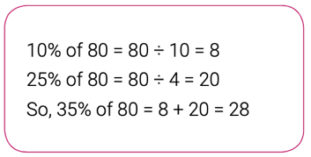
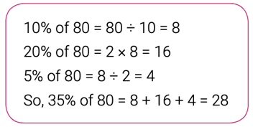
Key principle 4: Developing both fluency and understanding of key ideas
  Becoming fluent in basic maths skills frees up working memory, enabling learners to focus on reasoning and problem solving.
  Fluency is much more than simple recall of facts, it is also depth of understanding and application.
  Mathematical talk can develop fluency and encourage flexibility in the classroom, e.g. discuss ways to mentally work out 35% of 80.

Slide 8

Key principle 5: Developing a culture in which everyone believes everyone can succeed
  Years of ‘failure’ at maths, lead many FE learners to believe they can’t do maths
  To address this, a supportive and collaborative classroom is needed where mistakes are seen as an opportunity for learning.
  Shared language, empathy and understanding can help establish a low-threat/high-challenge culture that will increase students’ self-belief.
  Listening to students, giving them choices and developing positive relationships are part of this.

Slide 9

Teaching for Mastery in FE
For more information about the key principles, please refer to the CfEM Teaching for Mastery in Further Education handbook.

Slide 10

CfEM Resources and Evidence Hub
Visit the CfEM Resources and Evidence Hub for exemplar schemes of work, mastery lessons and much more.

Slide 11
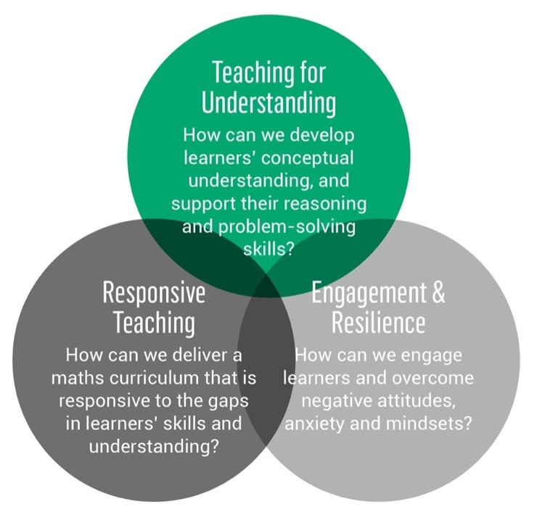
Action research: Three overarching questions
Relates to KPs 1,3,4
Relates to KP 2, 4
Relates to KP 5

Slide 12

And finally … how would your learners react to this question?

Slide 13


