Slide 1
Teaching for Mastery in FE Maths
SLIDE TO BE UPDATED ACCORDINGLY THEN DELETE THESE BANNERS
Module 1 – Engagement and resilience
PRESENTER NAME
DATE AND TIME
SLIDE TO BE UPDATED ACCORDINGLY THEN DELETE THESE BANNERS
Notes:
PD lead to personalise

Slide 2
Table activity – getting to know each other
SLIDE TO BE UPDATED ACCORDINGLY THEN DELETE THESE BANNERS
Possible things to talk about:
Name and place of work
What do you teach and how long have you taught for?
What is your favourite resource for engaging learners?
How are maths lessons in your college timetabled?
What do you think your maths team does well?
Tell me about a lesson that went really well.
SLIDE TO BE UPDATED ACCORDINGLY THEN DELETE THESE BANNERS
Notes:
PD Lead to decide on a task that encourages participants to get to know each other and to find out about how maths is taught in other settings. Suggestions of things to talk about are on the slide. Q3 would be a useful question for participants to discuss due to its relevance to the module.

Slide 3
01
Pre-session review and house keeping

Slide 4
Module 1: Motivation and engagement – developing resilient learners
SLIDE TO BE UPDATED ACCORDINGLY THEN DELETE THESE BANNERS
Welcome and introductions
House-keeping, health/safety – populate with relevant info
Introductions – participants can feed back some information from the ‘get to know you’ activity – adapt according to number of participants
Introduce Reflective log
Introduce the CfEM Resources and Evidence hub, including the course webpage and mastery handbook
SLIDE TO BE UPDATED ACCORDINGLY THEN DELETE THESE BANNERS
Notes:
RESOURCE HANDOUT 1.10
Introductions- name and college. Depending on numbers, take feedback on favourite resources and why it is effective.
Reflective Log - somewhere to make brief notes about items they can take away and use.
Course Padlet - contains all module resources and also suggested further reading etc. It will be demonstrated at the end of the module, or earlier if required.

Slide 5
02
Course introduction, aims and content

Slide 6

CfEM Resources and Evidence Hub
  The CfEM resources and evidence hub contains a bank of legacy materials for the sector that can be viewed and downloaded, including:
  Classroom resources
  Research evidence
  Professional development
  Whole college approach
  Included in the resources is the Teaching for Mastery in Further Education handbook.
Notes:
Provide a brief overview of the CfEM programme and introduce the legacy Resources and Evidence Hub.
Remind participants to read the Teaching for Mastery handbook, if they haven’t already.

Slide 7
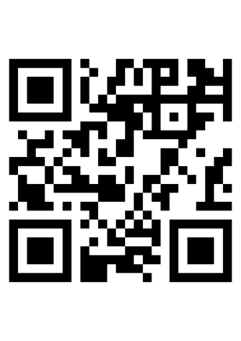
Teaching for Mastery in FE Maths course resources
Copies of all resources required for this course, including gap tasks, can be downloaded from the course page:
  Teaching for Mastery in FE maths modular course
Notes:
Show webpage to participants

Slide 8
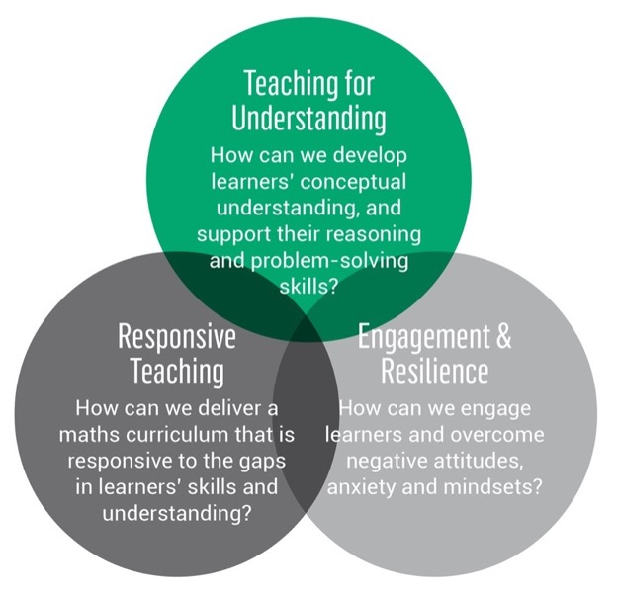
Reminder - Key principles & key questions
Relates to Key principle 5.
Teaching that allows students to develop an understanding of mathematical structure.
Valuing and building on students’ prior learning.
Prioritising curriculum coherence and connections.
Developing both fluency and understanding of key ideas.
Developing a culture in which everyone believes everyone can succeed.
Relates to Key principles 2 & 4.
Relates to Key principles 1,3 & 4.
Notes:
RESOURCE HANDOUT 1.8
Reinforcement of the three key questions and five key principles for mastery teaching, as outlined in the pre-course screencast.

Slide 9
Course aims
  By the end of the course, you will have:
  developed a toolkit of strategies to overcome learners’ negative attitudes, so that they become more resilient maths learners
  embraced ways of working which respond to gaps in learners’ skills and understanding, both in and out of the classroom
  adopted teaching approaches which deepen learners’ understanding of key concepts and improve learners’ mathematical reasoning and problem solving
Notes:
These are objectives for the WHOLE course. Objectives for Module 1 are on Slide 12.

Slide 10
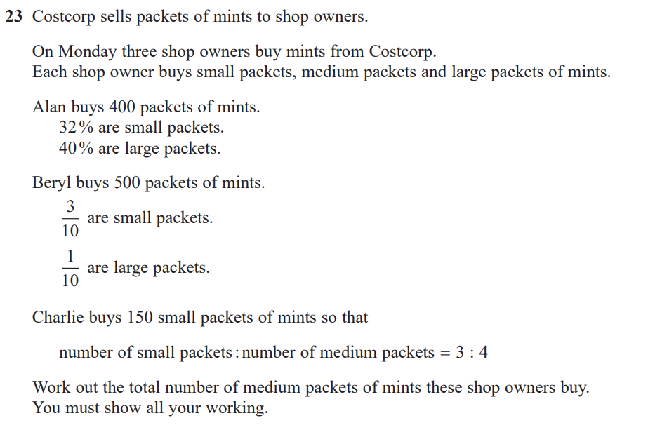
By the end of the course your learners will react positively to questions like this:
(5 marks)
Notes:
They may not all be able to get 5 marks but the aim is that they have the mindset and skills to make a start.
Exam question taken from: Pearson Edexcel Foundation Tier, Paper 3, June 2019. Available here: https://qualifications.pearson.com/en/qualifications/edexcel-gcses/mathematics-2015.coursematerials.html#filterQuery=Pearson-UK:Category%2FExam-materials

Slide 11
Course structure
Module 1: Engagement and resilience
Module 2: Responsive teaching
Module 3: Making sense of proportion
Module 4: Working with manipulatives
Module 5: Getting "unstuck"- reasoning and problem solving
Module 6: Planning for learning

Slide 12
03
About this module

Slide 13
Module objectives
On completion of this module, participants will have:
  a clear understanding of the negative attitudes and emotions that our learners face
  a bank of strategies to employ in lessons which will help to improve the engagement and resilience of learners

Slide 14
Today’s schedule
SLIDE TO BE UPDATED ACCORDINGLY THEN DELETE THESE BANNERS
**:** Review pre-session task and house keeping
**:** Course aims and content
**:** About this module
**:** Barriers to learning
**:** Capturing barriers
**:** Comfort break
**:** Teachers supporting learners
**:** Learners helping themselves
**:** Resilience
**:** Next steps
**:** Close
SLIDE TO BE UPDATED ACCORDINGLY THEN DELETE THESE BANNERS
Notes:
Add your timings

Slide 15
04
Barriers to learning
Notes:
Some of the content of this section will be familiar to participants, so keep the pace in this section fairly brisk and any discussion focussed.

Slide 16
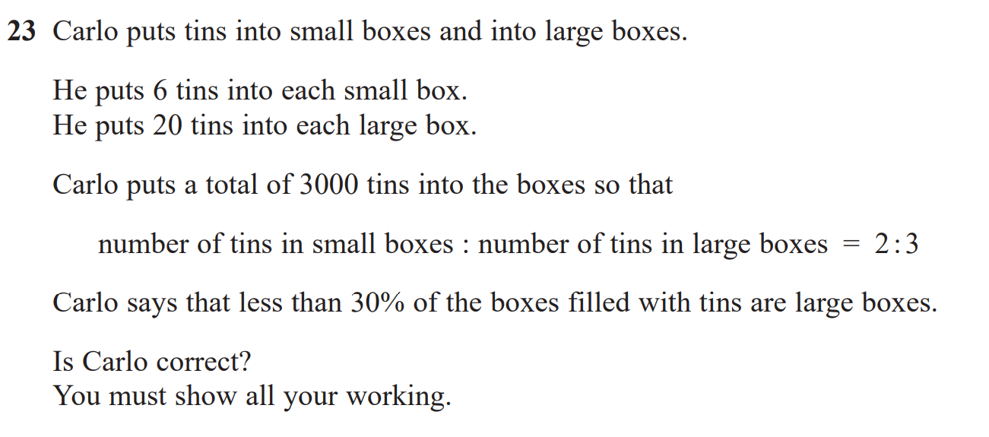
(GCSE exam question: Pearson Edexcel Foundation Tier, Paper 2, June 2020)
Notes:
RESOURCE HANDOUT 1.11
Set a timer for 1-2 mins. Build a tense environment. Perhaps use music to build the pressure.
‘We need to test your maths skills and want you to answer this question. You have 1-2 minutes to do this……”. Draw out feelings from participants. How did this make you feel? Discuss participants’ feelings and the similarities to learners’ feelings.
Exam question taken from: Pearson Edexcel Foundation Tier, Paper 2, June 2020. Available here: https://qualifications.pearson.com/en/qualifications/edexcel-gcses/mathematics-2015.coursematerials.html#filterQuery=Pearson-UK:Category%2FExam-materials
(Answer – No Carlo is not correct. 31% of the boxes filled with tins are large boxes.)

Slide 17

How do your learners feel?
Individually, write down one idea per sticky note.
On tables, arrange into themes.
Share with whole group.
Discuss findings as a group.
Notes:
Image: This Photo by Unknown Author is licensed under CC BY-SA-NC
Table activity. Ask participants to write down, on individual post-its, comments which learners have made to them about GCSE Maths/having to re-sit/having to continue to study maths. Post-its on each table are arranged into themes of group’s choice, and then shared and discussed with the whole group.

Slide 18
The affective domain
As teachers, we are trying to push a car with the handbrake on. Until the emotional handbrake is released, learners are unlikely to progress in the cognitive domain.
(Johnston-Wilder)
Affective domain | Cognitive domain
emotions | memory
attitudes | understanding
motivations | analysing
values | evaluating
Now select the sticky notes which you think belong in the affective domain.
Notes:
Introduce affective and cognitive domains. It is often the cognitive domain that is focussed on in teaching but they are inseparable. Unless the emotional issues are addressed, there is little prospect of engagement & progress in the cognitive domain. This session focuses on the affective domain. Emphasise the quote.

Slide 19

Learners’ maths journeys mean that many have developed a fixed mindset
What are the characteristics of a fixed mindset?
Notes:
Image: This Photo by Unknown Author is licensed under CC BY-SA, Microsoft online pictures
Ask participants to offer suggestions of behaviours suggesting a fixed mindset. Many students have developed a fixed mindset due to previous learning experiences.

Slide 20

Compare to Growth Mindset
What are the characteristics of a growth mindset?
Notes:
Image: This Photo by Unknown Author is licensed under CC BY-SA, Microsoft online pictures
Ask participants for characteristics of growth mindset. As FE maths teachers, this is what we seek to develop. Progress with maths re-sitters will be greater if learners have more of a growth mindset.

Slide 21

Have you met any teachers with fixed mindset traits?
Be aware of the effect we can have on learners. Their mindsets are fragile and easily damaged.
Minutes to damage, months to repair.
Notes:
Image: Microsoft online pictures.
Discussion: How would a teacher with a fixed mindset behave? (teacher resistant to change, has low expectations of learners,….).
Emphasise, if it does not arise in discussion, how easily a thoughtless remark from a teacher, can destroy a learner’s self confidence.

Slide 22
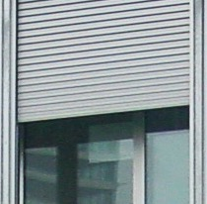
Maths Anxiety - a challenge. What is it? What are its effects?
"Maths Anxiety is defined as a negative emotional reaction to mathematics, leading to varying degrees of helplessness, panic and mental disorganisation that arises among some people when faced with a mathematical problem." (http://mathsanxietytrust.com/)
“Even with a very capable student, if the shutters come down, no learning will take place” (comment from teacher)
Notes:
This Photo by Unknown Author is licensed under CC BY-SA-NC (Microsoft image)
Introduce the concept of Maths Anxiety and its impact on working memory.

Slide 23

How common is Maths Anxiety?
Notes:
RESOURCE HANDOUT 1.12
Give participants time to read – shows prevalence of Maths Anxiety in society. Taken from https://www.pearson.com/content/dam/one-dot-com/one-dot-com/international-schools/pdfs/covid-19/guide-to-tackling-maths-anxiety-power-maths-report.pdf

Slide 24
At the start of the academic year, FE learners responded as follows:
65%: avoided doing maths questions that look difficult
50%: confidence when studying a maths qualification
90%: said they were unhappy or very unhappy about maths assessments
69%: get stressed during maths tests
37%: confidence when being asked to explain a maths formula
32%: responded positively about their maths confidence
Notes:
Explain that colleges have been researching motivation and engagement as part of their CfEM action research. They have created their own questionnaires and surveys which have generated this data.

Slide 25
05
Capturing barriers

Slide 26
How would you know if a learner was anxious?
Notes:
Discuss. What does anxiety look like? Behavioural issues? Fidgeting? Pen tapping? Anger? Hiding away? Do they mask their fear? Are they anxious behind a loud, confident front?

Slide 27
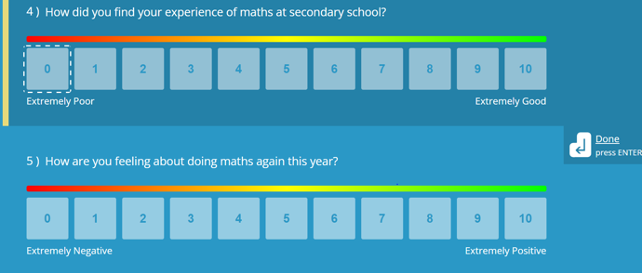
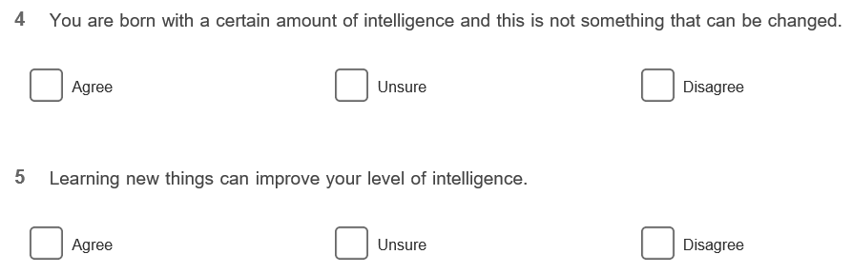
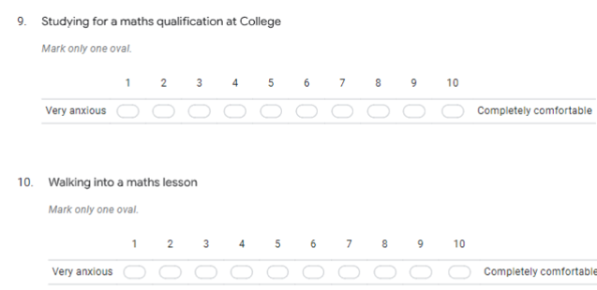
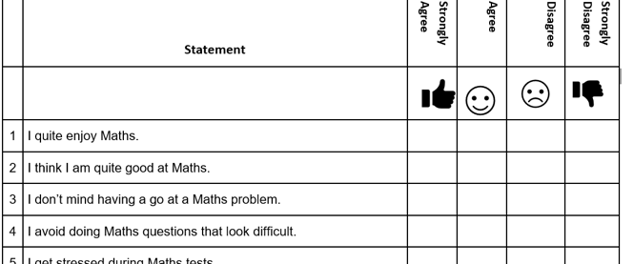
How can we capture our learners’ barriers, feelings and support needs?
As part of CfEM action research, several colleges have created questionnaires in order to capture learners’ barriers, feelings and attitudes to learning. Here is a selection.
Education & Training Foundation
Notes:
RESOURCE HANDOUTS 1.4 TO 1.7

Slide 28
Questionnaire review:
What do you notice?
Are there similarities?
What are the differences?
Which of these questionnaires would you choose to adapt or use in your setting, and why?
Often, the first experience that the learners have at the beginning of term is having to complete a substantial maths assessment. How must this make them feel?
Education & Training Foundation
Notes:
Give out one copy of each questionnaire to every participant then facilitate the activity on the slide. Each group should be directed to start with a different questionnaire. Discuss on tables then share reflections with whole group.
Background information for trainer below.
WCG: paper document of 20 questions. 4 options: strongly agree/ agree / disagree and strongly disagree. Explores how learners feel about their maths ability and what traits are needed to learn maths.
CRC Maths Anxiety: Coloured Microsoft Form of 11 questions. Explores how learners feel about learning maths, asks for suggestions on how they can be supported and their reaction to certain maths situations.
CRC Mindset of 9 questions about their maths mindset and beliefs. Created using survey maker https://freeonlinesurveys.com
Plymouth: 18 questions. Asks about how they learn best e.g. group work? online? How they feel in certain scenarios. Includes more open questions such as where they see themselves in five year's time and whether they would like to access support for their maths.

Slide 29

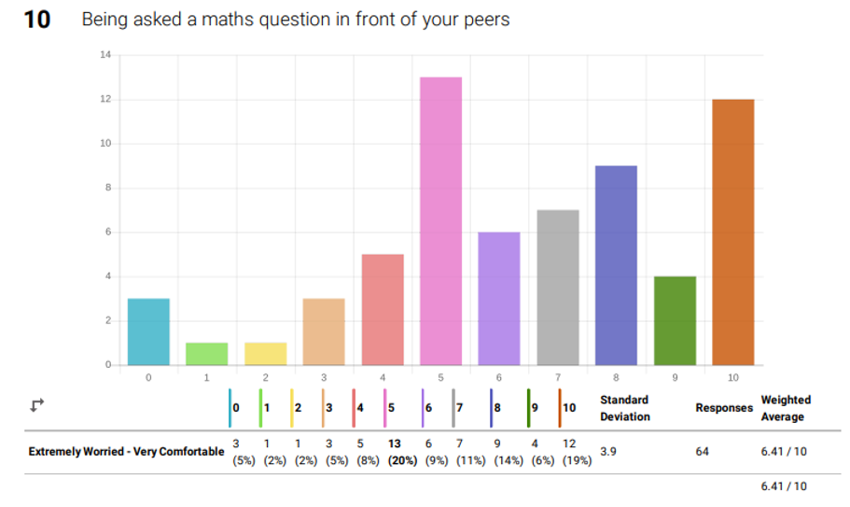
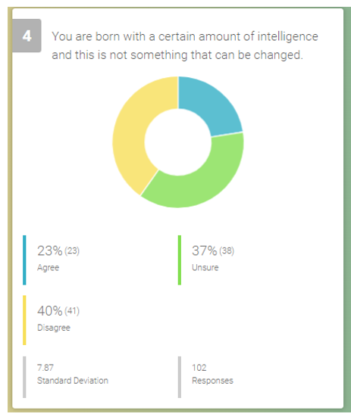
CRC Questionnaire results format:
Effective visual display of results. The software allows drilling down to individual students too.
Education & Training Foundation
Notes:
RESOURCE HANDOUT 1.13
Example of output from CRC software, showing distribution of responses to questions as both bar chart and pie chart.

Slide 30

Using questionnaires at Cambridge Regional College
As you watch, look out for:
anything that surprised the teachers
ways in which they used the results to re-assure learners
ways in which they used the results to influence how they worked with learners.
Credits: Julie Savage, Georgie Norris and Sarah Stokes, Cambridge Regional College
Notes:
Click video icon to take you straight to YouTube video. Sound quality not always good in large room, so use subtitles button(CC on bottom right).
Points to bring out briefly after viewing video:
Both growth mindset and anxiety are measured.
Results used as a starting point for teaching
Class results shared with learners – reassures them to know that quite a few others in the class are anxious too
Used across whole college.
YouTube link, in case of problems. https://youtu.be/d7IoYZQbhy8
Invite participant comments on what they see.

Slide 31
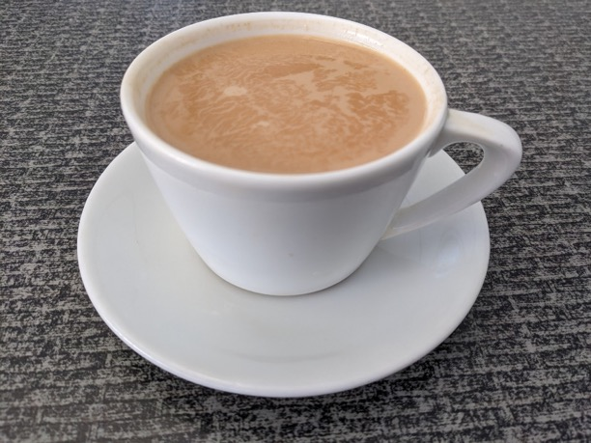
Break

Slide 32
06
Teachers supporting learners

Slide 33

Classroom culture
The learners coming into the FE maths classroom often have a fixed mindset, may have a negative attitude and could have maths anxiety.
What can we do to support them?
Pass the poster activity
4 posters:
Classroom relationships
Teacher communication
Physical environment
Activities
Note down anything that could support students
Notes:
Think about how best to organise this activity depending on the size of room and number of participants. Prepare one poster for each heading (more if a large group). Ideal group size is 2-3. The aim is that participants read each other's contributions and add additional ones. The posters can be passed around, or the participants can move between tables, or the posters can be stuck to walls or doors, and worked on there. Allow 3 mins per poster. At the end give 5 minutes reading time of all posters and then ask for feedback.
Make sure that the following points are made during feedback:
importance of facilitating peer to peer relationships
taking learners outside the classroom
the value of listening
body language – get down to the students’ level
positioning of teacher in the classroom. Are teachers stuck at the front or moving around the room?
MAINTAINING working relationships – esp at pinch points e.g. after Nov re-sit.
making the qualification meaningful – make the maths relevant/stress its importance in industry
humour

Slide 34
Relationships – the research
The research is clear: student-teacher relationships significantly impact teacher effectiveness and student achievement.
Features of positive relationships are
  empathy
  warmth
  encouragement
  authenticity
  respect for student backgrounds
A student who feels respected, cared for and connected to their teacher has increased motivation to listen, learn and achieve.
.Adapted from Hattie, J. (2009), Visible Learning
“If the relationship is good you can teach in a shed.”
(Teacher comment)
Notes:
To be read with participants –
From the poster activity it should be evident that the teacher – student relationship is key.

Slide 35

City College Plymouth : Alternative learning environments​
City College Plymouth conducted maths lessons out of the maths classroom. They worked with ratio and measurement in hospitality settings, created an orienteering tour of the campus, measured running speeds and designed a murder mystery activity involving several maths topics.
Students liked them!
92.5%
I prefer this to my normal lesson
94%
I enjoyed the sessions
83.5%
I joined in more than usual
Notes:
Taking learners out of the classroom is one way to engage learners.​

Slide 36
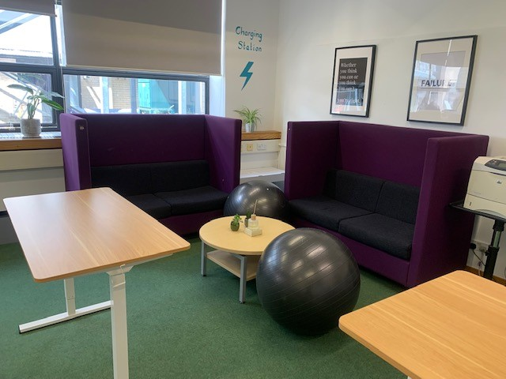
Focus on the physical environment at Cambridge Regional College
Notes:
Exercise balls for fidgety students / plants / quiet corner. Standing desks as alternative to sitting. Sofas for focussed group work. Motivational posters on the walls. Charging station in the corner for phones.

Slide 37
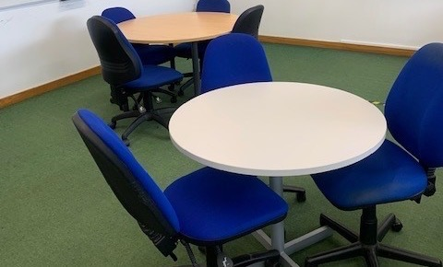
Focus on the physical environment at Cambridge Regional College
Notes:
Round tables to promote discussion. The teacher has exactly the same table and chair as the students.

Slide 38
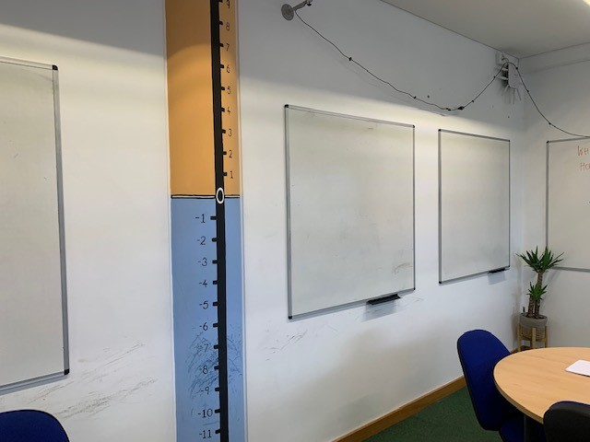
Focus on the physical environment at Cambridge Regional College
Notes:
No maths on the wall apart from this number line. Motivational posters in room but not maths posters. The department found that the maths posters made the learners more anxious. They want the FE classroom to feel different from and more adult than a school one. Numerous white boards on walls allow for small group work and ease of differentiation. All equipment except standing desk upcycled for free from other areas of the college.

Slide 39


Focus on the physical environment at Cambridge Regional College
Notes:
Posters designed and produced by maths staff.

Slide 40

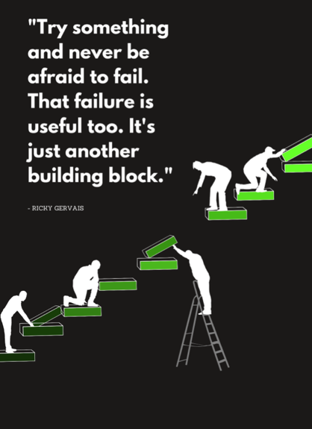

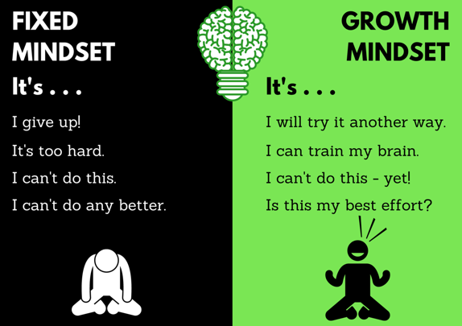
Focus on the physical environment at Cambridge Regional College
Notes:
Posters designed and produced by maths staff.

Slide 41
Ways in which teachers support learners
As you watch, look out for the ways in which these teachers support learners.
Credits: Julie Savage, Georgie Norris and Sarah Stokes, Cambridge Regional College
Notes:
Click video icon to take you straight to YouTube video. Sound quality not always good in large room, so use subtitles button (CC on bottom right)..
After viewing, draw out from participants briefly the Importance of
Relationships
Teacher and student expectations of each other., based on mutual respect.
Positivity – making positive comments on what students CAN do.
YouTube link, in case of problems, https://youtu.be/PAxt4Zr5saU

Slide 42
07
Learners supporting themselves

Slide 43
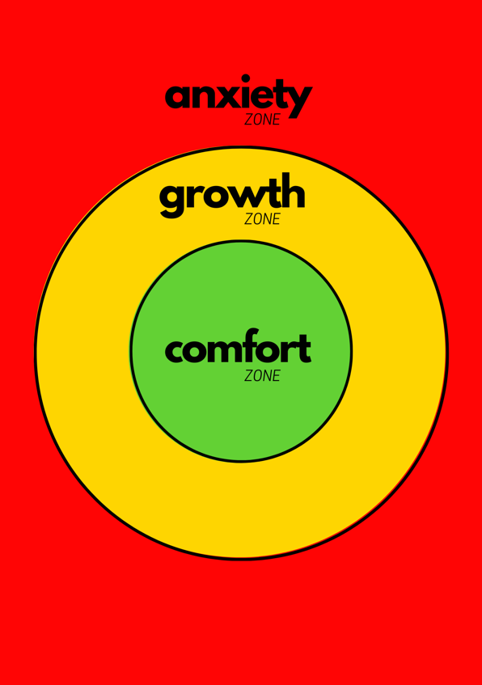
Growth Zone – a model which students have found useful in dealing with their anxiety
  Cruising in the comfort zone can build self-confidence & provide opportunities for practice & development of fluency.
  New learning happens in the growth zone. It should be safe to make mistakes, get stuck, require support & find activity challenging & tiring.
  The anxiety zone is where what is being asked is not within the learner’s reach at the moment, even with support. Stress increases and little or no useful learning takes place.
Johnston-Wilder, Lee
Notes:
RESOURCE HANDOUT 1.9
How did participants feel when doing the timed maths question at the start of the session? Outline the meaning of the zones. Discuss what puts participants in the anxiety zone when doing something stressful and what they can do to move into the growth zone.

Slide 44

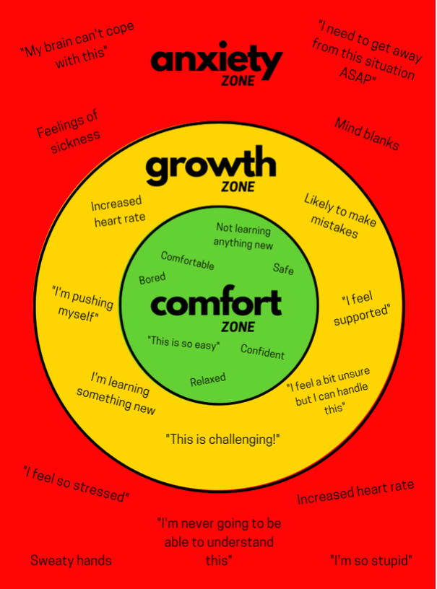
Growth Zone model
Student comments/reactions captured during action research on what it feels like to be working in each of these regions. Led to the creation of this adapted Growth Zone model.
Notes:
RESOURCE HANDOUT 1.14
Explore student comments about what it feels like to be in each zone.

Slide 45
What does it mean to be in the Growth Zone?
“Safe” - learner feels safe to make mistakes
“Safe” - learner feels safe enough to give it a go
“Safe” - learner feels safe enough to ask for support
How can teachers encourage learners to feel safe?
“Mistake” – Means I Start To Acquire Knowledge Experience and Skills
“FAIL” - First Attempt In Learning
“Stuck” – what can learners do about it? (poster)
“Not yet” - promote the concept of ‘not yet’
Challenging and tiring” – the brain uses about 20% of daily calorie intake – of course all that thinking will be tiring!
Notes:
Discuss characteristics of being in the growth zone. This is where learning takes place and this is where we want our students to be. We need to plan our classroom practice to support this.

Slide 46
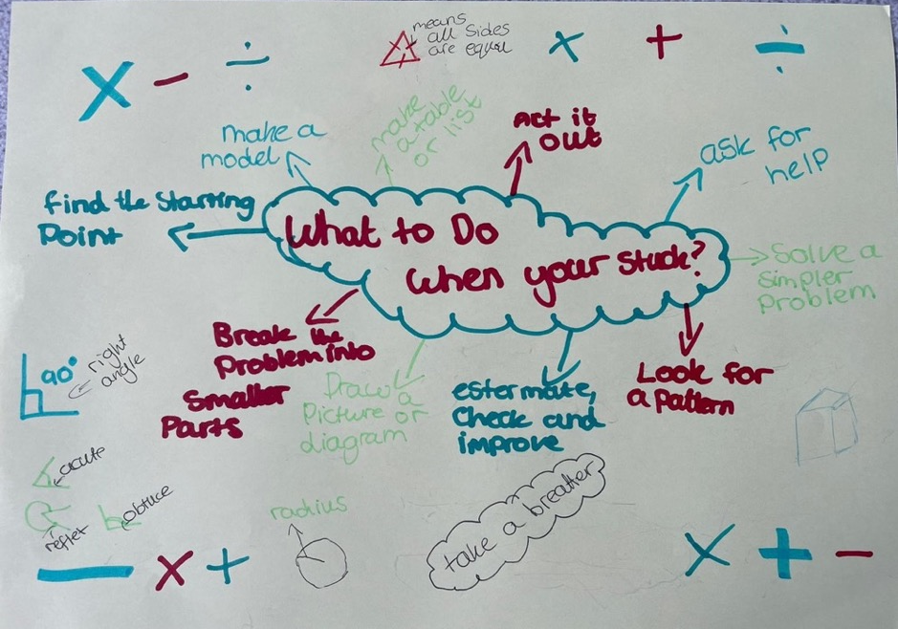
‘Stuck’ poster from a college
Notes:
Example of stuck poster – learners have ownership of the suggestions.

Slide 47
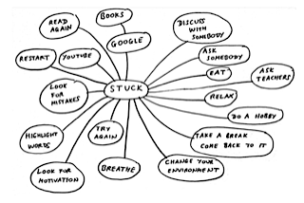
Second example of stuck poster
Notes:
Constructed by learners collaboratively on class whiteboard

Slide 48
08
Resilience

Slide 49
What does maths resilience look like?
Our aim is to make our learners more resilient
In order to be mathematically resilient a learner must:
understand the need to STRUGGLE. Learning mathematics can be difficult, but overcoming obstacles brings success and satisfaction.
have a GROWTH mindset, believing that, with the right sort of help, their learning can grow.
have resources available to SUPPORT their learning. These might be friends and teachers, textbooks or material available on the internet.
Adapted from Lee and Johnston-Wilder (http://mathematicalresilience.org/)
Notes:
Emphasise that everything in this module has exemplified ways of combatting students’ negative beliefs and anxieties by making them more mathematically resilient.

Slide 50
Putting it all into practice – CfEM case study
A network college has been investigating how student behaviours and attitudes change in the classroom following the use of positive language in class.
This is what one teacher wants to share with his colleagues about the use of growth mindset in his classroom.
Notes:
RESOURCE 1.15
Give a concise introduction to this activity which models much of the content of this module.
First of all, ask participants to answer the question.
Next, find four volunteers to read teacher and student roles (with expression!) using script provided. Ask remaining participants to focus on teacher responses to learners and share what they observe. You will need to time the slide changes carefully.
The learning points from the dialogue are:
Socratic questioning
affirming student successes where possible
responsive teaching which builds on learner responses.

Slide 51

Demo of Growth Mindset in practice

Slide 52
The question learners were asked to attempt
3 kg of carrots cost £1.80
2 kg of carrots and 5kg of potatoes cost a total of £3.45
Work out the total cost of 4kg of carrots and 2kg of potatoes.
You must show your working.
Have a go at the question so you know what problems students might experience.

Slide 53
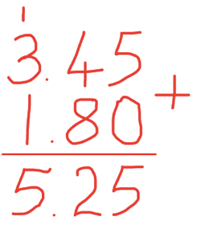
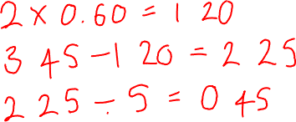
The teacher - student dialogue
3 kg of carrots cost £1.80
2 kg of carrots and 5kg of
potatoes cost a total of £3.45
Work out the total cost of 4kg of carrots and 2kg of potatoes.
You must show your working.

Slide 54
Conclusion - Growth Mindset in practice
I have seen a greater number of interactions and engagement: peer to peer and teacher to peer.
More frequent constructive class discussions.
More Students with a ‘can do’ attitude.
Students enjoying and appreciating their learning.

Slide 55
Alternative to ‘Growth Mindset in practice’ slides – Case studies
Choose a case study and discuss on tables how you might work with this learner.
Notes:
RESOURCE 1.16
Distribute the "Case studies" handout. Give tables five minutes to discuss one or more students, and then take feedback.

Slide 56
09
Next steps

Slide 57
What changes will you make in your practice?
Use the Reflective log to review the content of this module.
Commit to making one change in your practice before attending the next module. Be specific. Exactly what will you change and when?
Share this change on tables or with whole group

Slide 58


Gap tasks
Read the following before attending Module 2:
Motivation and Engagement: Practical ideas for developing positive attitudes towards maths in FE colleges
A diagnostic and responsive approach to teaching Maths Functional Skills and GCSE re-sits
Notes:
Sharing a commitment to change one’s practice makes it more likely to happen. PD Lead chooses how this is shared - orally, privately, set up a WhatsApp group, other….. Prompts might be
What will participants take away and try out/share with others?
What might they do differently at the beginning of the academic year?
Outline gap task

Slide 59


Further CfEM engagement and resilience resources
Practical approaches to engage learners and develop mathematical resilience: an intervention for FE maths
Using mastery approaches: engagement and resilience screencasts and other resources
Principles and Practice: motivating and engaging students in FE Maths
CfEM action research reports (scroll to Mathematical Resilience)
Notes:
This slide provides links to resources and publications with further practical ideas for developing learner engagement and resilience in FE maths which have been produces as part of the CfEM programme.
All resources are fee to download from the CfEM Resources and Evidence Hub: https://www.et-foundation.co.uk/professional-development/maths-and-english/cfem/cfem-resources-and-evidence/

