Slide 1
Teaching for Mastery in FE Maths
SLIDE TO BE UPDATED ACCORDINGLY
Module 6 Planning for Learning
PRESENTER NAME
DATE & TIME
SLIDE TO BE UPDATED ACCORDINGLY
Notes:
Title Slide - to be updated by deliverer of PD, and yellow parts removed.
Slide background colour for text: #F5F5F5

Slide 2
01
Welcome
Notes:
Divider Slide

Slide 3
Housekeeping
SLIDE TO BE UPDATED ACCORDINGLY
This slide to be populated with housekeeping and health/safety information
SLIDE TO BE UPDATED ACCORDINGLY
Notes:
To be updated by deliverer of PD, and yellow parts removed.

Slide 4
02
About this module
Notes:
Divider Slide

Slide 5
Reminder – course structure
Module 1: Engagement and resilience
Module 2: Responsive teaching
Module 3: Making sense of proportion
Module 4: Working with manipulatives
Module 5: Getting "unstuck"- reasoning and problem solving
Module 6: Planning for learning
Notes:
Reminder of course structure.

Slide 6
Aims of Module 6
On completion of this module, delegates will have:
  explored the key principles needed when planning for mastery teaching and learning in FE maths
  examples and strategies to employ in their own settings
Notes:
Aims of the session to be shared with participants

Slide 7
Module content
01 Welcome
02 About this module
03 Two approaches to curriculum design
04 Mastery curriculum prioritisation
05 Mastery curriculum collaborative planning
BREAK (15mins)
06 Mastery lesson planning
07 Course reflections
08 Next steps

Slide 8
03
Two approaches to curriculum design
Notes:
Divider Slide

Slide 9
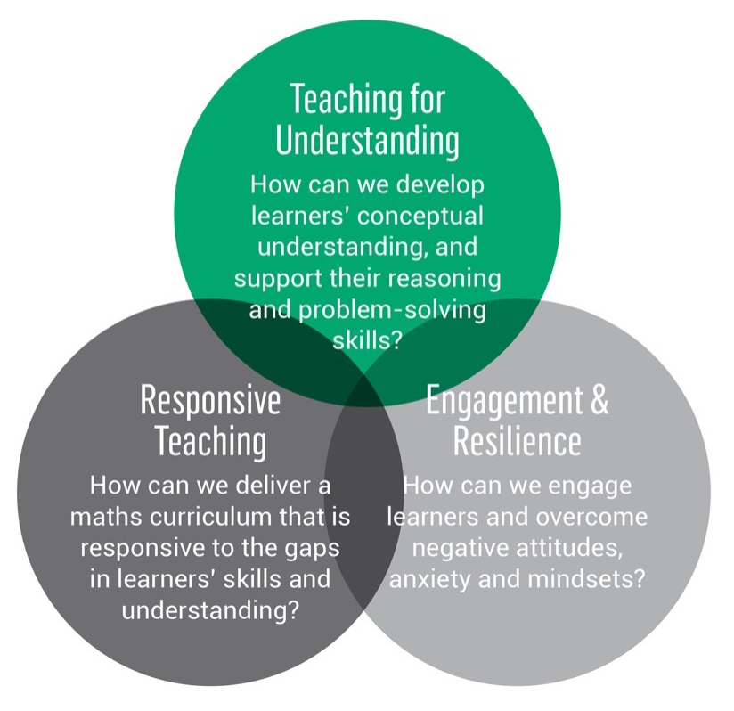
Reminder – key principles and key questions
Relates to Key principle 5.
Teaching that allows students to develop an understanding of mathematical structure.
Valuing and building on students’ prior learning.
Prioritising curriculum coherence and connections.
Developing both fluency and understanding of key ideas.
Developing a culture in which everyone believes everyone can succeed.
Relates to Key principles 2 & 4.
Relates to Key principles 1,3 & 4.
Notes:
Reinforcement of the three key questions and five key principles for mastery teaching.

Slide 10
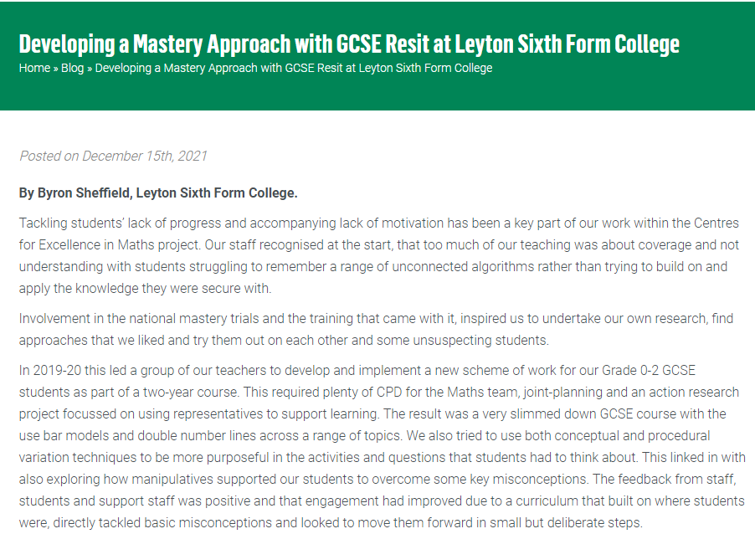
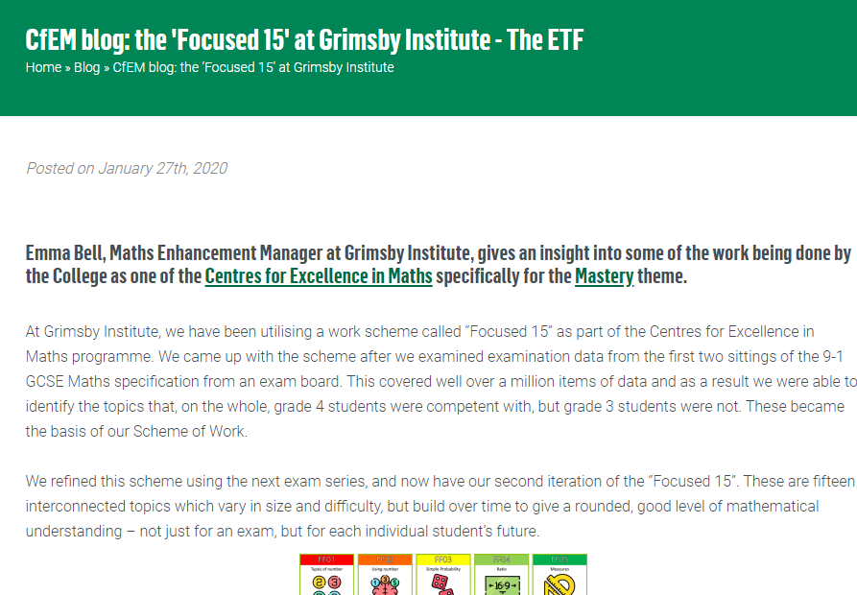
Two Approaches to Curriculum Design
The pre-session task asked you to read two ETF blog posts which concentrate on Curriculum Design and Mastery Approaches in FE
Notes:
RESOURCE HANDOUT 6.4
Gap task between modules 5 and 6 – to read 2 blog posts from CfEM centres taking different approaches to curriculum design.
Blog posts available as a pdf on padlet and at original source:
https://www.et-foundation.co.uk/cfem/resit-mastery-leyton-sixth-form/
https://www.et-foundation.co.uk/cfem/cfem-blog-the-focussed-15-at-grimsby-college/
Printouts should be available for groups to refer to during this task.

Slide 11
Two Approaches to Curriculum Design
Discuss:
  What’s similar in the approaches of these two CfEM Centres?
  What’s different? Why do you think this is?
  Collate your thoughts in a Venn diagram using post-its and flipchart paper.
Leyton
Grimsby
Notes:
AIM: For participants to examine different approaches and appreciate that colleges can look at curriculum planning and design from many perspectives – all whilst aligning with the 5 Key Principles.
Participants use sticky notes and flipchart paper to record similarities and differences in a Venn diagram.
(Extension - Use outside the rings for curriculum designing elements that participants identify as not being covered in the blog posts.)

Slide 12
LEYTON
GRIMSBY
Reduced SoL
Use of visual representations
Student is in charge of journey
Teachers freed up for professional development
Connections focussed
Notes:
Example of possible answers – not exhaustive.
Image generated during PD Lead training.

Slide 13
LEYTON
GRIMSBY
2 year course for 0-2 grade students
Fewer topics
Track student journey
Representations
Spend time on what is needed
Focus on 0-2 students
Exam ready
Connections between topics
Diagnostic assessment
Notes:
Example of possible answers – not exhaustive.
Image generated during PD Lead training.

Slide 14

Pre-session task review
Feedback
Notes:
Facilitate feedback from the groups.
PD leads may wish to draw/make a ‘crowd sourced’ Venn diagram of similarities and differences on a board at the front of the room.
Draw out that the common points in each blog exemplify the Key Principles, with the differences showing adaptation for context/setting and professional judgement.
Image – Microsoft365 Stock Image

Slide 15
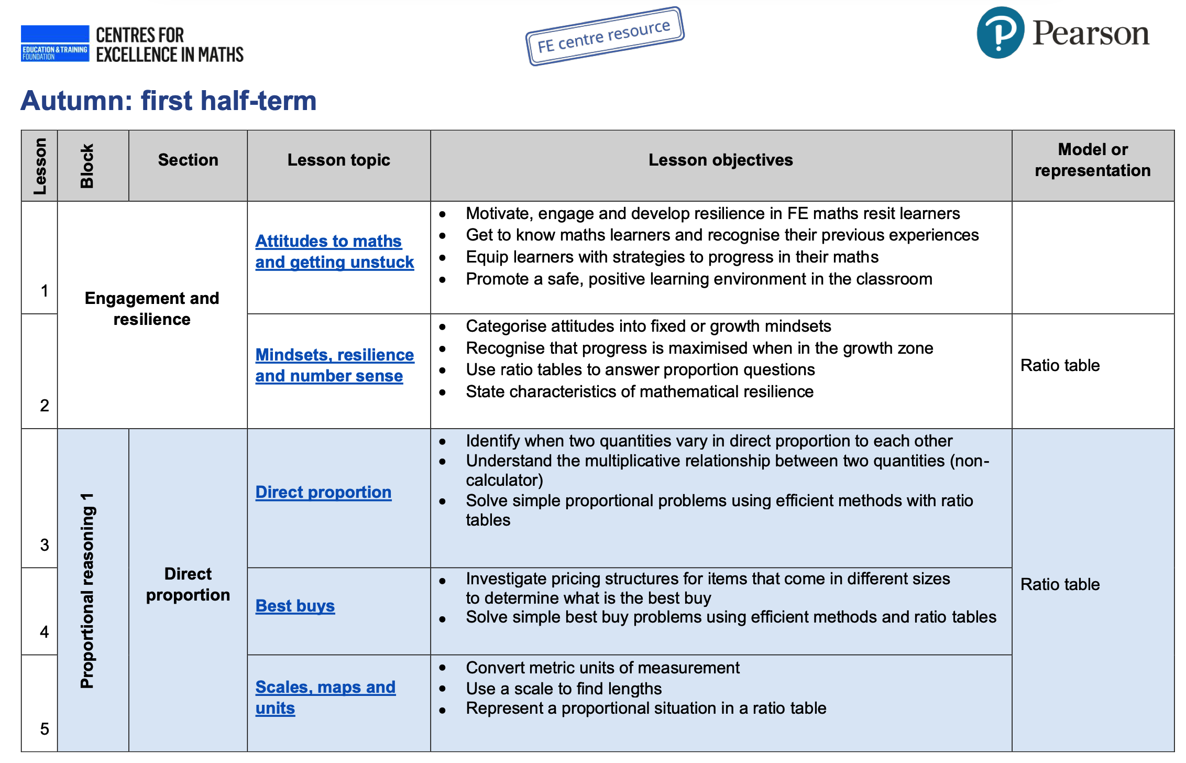
CfEM scheme of work
Read the rationale for the CfEM scheme of work and browse the content. You can choose between:
GCSE re-sit
Functional Skills level 2
Functional Skills level 1
Consider:
What considerations have informed this scheme of work?
How does this relate to the curriculum design approaches from task 1?
How could you adapt this scheme of work for your teaching?
Notes:
Gap task 2 – to read the rationale for the CfEM schemes of work.
Group participants according to which curriculum they wish to focus on:
GCSE re-sit
Functional skills level 2
Functional skills level 1
Printouts of the relevant scheme of work should be available to each group.
Allow time for discussion of the three questions on the slide, then take feedback on Q1 and Q2

Slide 16
CfEM scheme of work
Focus on a limited number of key concepts
Highlighting links between mathematical concepts
Visual representations across topics (Leyton)
Plus an added focus on:
Learner engagement and resilience
Less emphasis on individualised approaches for different learners
Notes:
Use slide 16 as appropriate to confirm the key points
Finish with a brief discussion of Q3. Prompt:
Would they use the scheme of work as it is?
If not, how would they use it or adapt it?
What about the issue adaptation to the needs of learners? How could that be accommodated?

Slide 17
04
Mastery Curriculum Prioritisation
Notes:
Divider Slide

Slide 18
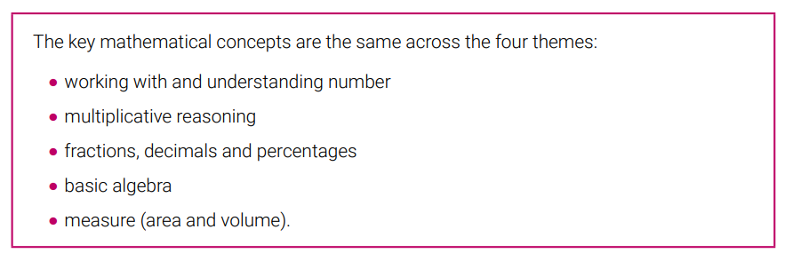
Key Mathematical Concepts
WHY THESE CONCEPTS?
Notes:
Snip taken directly from the CfEM Mastery in FE Handbook: https://www.et-foundation.co.uk/wp-content/uploads/2020/03/CfEM_Mastery_Handbook.pdf
These five key concepts are highlighted in the handbook as being the most fundamental for Teaching for Mastery in FE Maths from both a qualification and a life-skills perspective.
Animated banner to prompt question: Why these concepts?
Participants will discuss the concepts in the next activity.

Slide 19
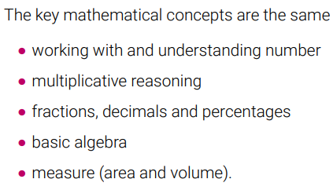
Key Mathematical Concepts
Each group will be the advocate for one of these concepts.
You will decide why the concept is classed as ‘Key’ from both a qualification and a life-skills perspective.
Each group will put their case to all participants – but you’ll only have 2 minutes to speak!
Notes:
Group task
PD Lead to assign a concept to each group.
Each group will decide why the concept is classified as ‘key’ from both a qualification and a life-skills perspective. For example – why is basic algebra needed for the Post-16 compulsory maths qualification, and why is it needed as a life skill?
This could mean Functional Skills, GCSE or both.
Each group will then put their case to the rest of the participants – but will have a two minute time limit in which to speak.
Use a timer for this.
The next 5 slides have banners for each concept that can be displayed as each group speaks.

Slide 20
Working with and understanding number
Notes:
Set of 5 slides with the concepts on that can be displayed as each group speaks.

Slide 21
Multiplicative reasoning
Notes:
Set of 5 slides with the concepts on that can be displayed as each group speaks.

Slide 22
Fractions, decimals and percentages
Notes:
Set of 5 slides with the concepts on that can be displayed as each group speaks.

Slide 23
Basic algebra
Notes:
Set of 5 slides with the concepts on that can be displayed as each group speaks.

Slide 24
Measure (area and volume)
Notes:
Set of 5 slides with the concepts on that can be displayed as each group speaks.

Slide 25

Key Mathematical Concepts
The cases that each group has put forward are the type of conversations that should happen during curriculum and lesson design.
Notes:
The cases that each group puts forward are the type of conversations that should happen during curriculum and lesson design.
Everything included within a scheme of learning should be there for good reason (and help with answers to the perennial learner question: WHY AM I DOING THIS?)
Teams across the CfEM programme have been working collaboratively on exemplar schemes of learning – the next activity will mirror the processes they have been using to do that.
Image – Microsoft365 Stock Image

Slide 26
05
Mastery Curriculum Collaborative Planning
Notes:
Divider Slide

Slide 27
Sample Collaborative Planning Process
Agree Topics
CfEM centres worked in groups to agree which topics they would include in the scheme, and which they wouldn’t
Groupings
Discuss how the topics can be grouped together
Models and Representations
Decide which models and representations would be most appropriate to each topic
Sequencing
Decide the order of the topics based on overlapping mathematical structure, common models/representations and engagement issues
Notes:
Diagram animates to explain the process used by the CfEM programme in its curriculum planning as an example of an approach that can be taken.
Explain each once as they animate onto the screen.
Emphasis is on professional collaboration and looking for connections.
Groups are now going to go through a streamlined version of this process.

Slide 28
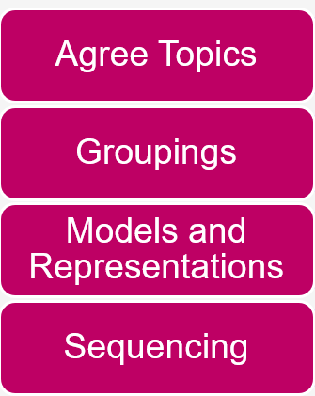
Sample Collaborative Planning Process
Using your Key Concepts from the previous activity:
What topics would be included in your concept?
How can you group them together?
What models and representations would you use?
How would you order the topics?
Notes:
This streamlined planning process activity only focuses on one key concept per group (the concept that the group advocated for in the previous section)
More realistic planning would include all concepts, but this activity will give a flavour of the conversations and methods that can be scaled up in a department meeting.
Each group should be provided with post-its and flipchart paper to facilitate this process.
Photographs can be taken and shared of the final products, but the process is what it most important here.

Slide 29
Key Mathematical Concepts
Notes:
Reminder of the concepts.

Slide 30
Sample Collaborative Planning Process
Feedback
Notes:
Take feedback from the groups on how they found the process and how they can see it working on a larger scale.
How could they foster this approach in their own settings?
Would change need to happen first?
Image – Microsoft365 Stock Image

Slide 31

Break

Slide 32
06
Mastery Lesson Planning
Notes:
Divider Slide

Slide 33
University of Nottingham research trial
A set of lesson design features were developed by the University of Nottingham and used to design research lessons for their Teaching for Mastery research trial.
The design features were closely related to CfEM’s 5 key principles of teaching for mastery
The research showed that where teachers used these lessons as part of a lesson study intervention, their learners gained an average of one month’s additional learning – or two months in the case of the most deprived learners.
For more details of the research, see the evidence section of the CfEM Hub.
Notes:
Explain how a set of ‘lesson design’ features were developed by the University of Nottingham, based on the 5 key principles of teaching for mastery, and how they informed research lessons used in the research conducted by the university as part of CfEM.
Point out links to the research lessons developed by the university and the research reports.

Slide 34
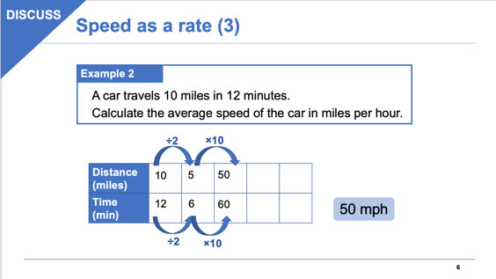
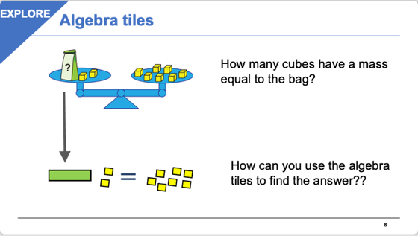
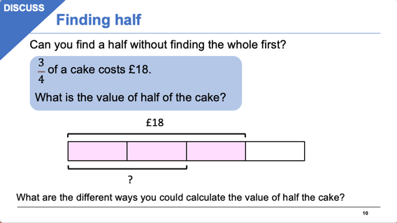
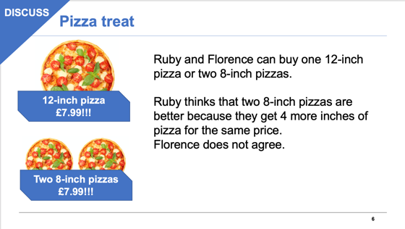
Utilising the lesson design features
Later, the same design features were used by CfEM teachers to develop the lessons featured in the CfEM scheme of work:
30 GCSE resit lessons
18 Functional skills level 2 lessons
16 Functional skills level 1 lessons
34
Notes:
Explain how the same design features were adopted by CfEM teachers and used to develop the lessons which feature in the CfEM schemes of work – highlight the links to these.

Slide 35
Teaching for Mastery in FE Maths – Lesson Design Features
Identify and build on prior learning
Use familiar contexts to introduce maths concepts
Address common misconceptions
Use visual representations and/or manipulatives
Connect different areas of maths where possible
Actively engage learners through collaborative activities
Notes:
Introduce CfEM’s Lesson Design Features for Teaching for Mastery in FE Maths.
All modules up to now have exemplified methods and techniques for teaching for mastery in FE maths.
The design features bring these all together.
Slide is animated with the features coming in one by one.
Call on participants for input during this – what connections can they make with the previous modules?
Here is a brief overview of each one, if needed:
Build on prior learning
•Provide opportunities to check & build on learners’ prior understanding of the topic
•Build on previous lessons in the scheme of learning
Introduce and develop concepts through context
Where appropriate, use a context to introduce & develop the lesson which:
•Is relatable to 16-19 FE learners
•Can be used to highlight mathematical structure
Foreground common misconceptions
Expose & address misconceptions through activities that provoke reasoning or cognitive conflict (e.g. by sampling student thinking)
Highlight mathematical structure
Where possible, use models, representations & manipulatives to highlight mathematical structure
(e.g. bar model, ratio table, number line, algebra tiles, geoboards)
Connect different areas of maths where possible
Connections across mathematical topics such as connecting multiplication with area.
Connections within concepts that support progression within a topic
Mathematical connections with real life situations
Active and collaborative engagement
Discussion which focuses on different methods & approaches (rather than checking answers)

Slide 36
Mastery lesson carousel
  A sample of CfEM mastery lessons has been laid out on different tables around the room
  Some have been written by teachers and some by University of Nottingham
  All have been guided by the six lesson design features
  For each lesson, you will find:
    A set of slides
    Lesson plan/overview
    A key activity from the lesson
Notes:
You should select 4 to 6 lessons from those provided for this lesson. (You can substitute other CfEM lessons, if you prefer, including those written for Functional Skills). Lay out the lesson resources on separate tables (one per lesson), together with an A3 copy of 6.9 – Mastery lesson carousel.
Introduce the lessons, using the points on the slide.

Slide 37
Mastery lesson carousel
  Working in groups of 3:
  Visit at least 3 or 4 of the tables, spending about 12-15 min at each
  Familiarise yourself with the lesson and key activity
  Discuss:
    How well have the lesson design features been met?
    What do you like about the lesson?
    How might you adapt or amend the lesson?
  Read any feedback already recorded on the A3 sheet and add your own comments
Notes:
Explain the activity, and organise participants into groups of 3.
Allow up to an hour for this activity, with groups circulating to different tables to look at different lessons every 12-15 minutes. You might want to time this and ask groups to move to another table after a certain time, so that they are able to sample several different lessons.
Before moving to the next table, participants should write brief feedback on handout 6.9 for the next group to read – who then add their feedback and so on.

Slide 38

Feedback
How easy was it to spot the design features in the lessons?
Which lessons would you use with your learners? Why?
How might you adapt or amend the lessons?
Notes:
After about an hour on the carousel of lessons, bring the group together again to discuss the activity and gather summative feedback. Use the three questions shown to guide a whole group discussion.

Slide 39
Sources of similar lessons
DfES Standards Unit: Improving Learning in Mathematics, 2005
Maths for Life: Thinking Through Mathematics, 2007
Mathematics Assessment Project, 2007-15
Notes:
These are links to other lessons and activities produced over the last 20 years, which are similar in style and content to the CfEM lessons.

Slide 40
07
Course Reflections
Notes:
Divider Slide

Slide 41

Reflections
Notes:
Time to round everything off nicely.
Go through what’s been achieved since module 1 (Next slide has an image from each module which can be used during recap)
Allow each group collaborative time to reflect on their journey through the modules.
Prompts:
What have you achieved?
What has had most impact?
What do you want to develop further?
Image – Microsoft365 Stock Image

Slide 42
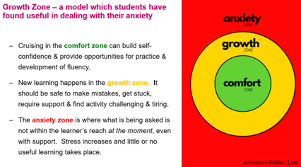
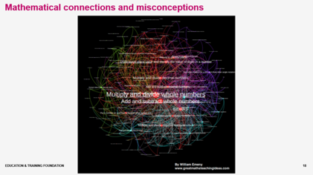
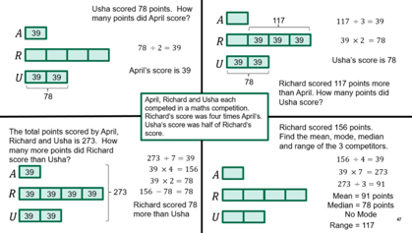
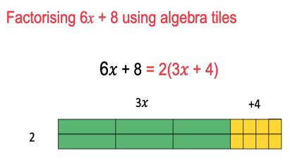
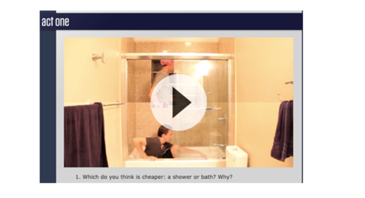
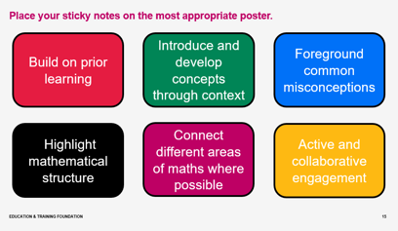
Reflections
Module 1
Motivation and Engagement
Module 2
Responsive Teaching
Module 3
Making Sense of Proportion
Module 4
Working with Manipulatives
Module 5
Getting Unstuck
Module 6
Planning for Learning
Notes:
Reminders of each module.

Slide 43

Reflections
What have you achieved?
What has had most impact?
What do you want to develop further?
What’s next?
Notes:
Reflection prompts for display during discussion:
What have you achieved?
What has had most impact?
What do you want to develop further?
Image – Microsoft365 Stock Image

Slide 44
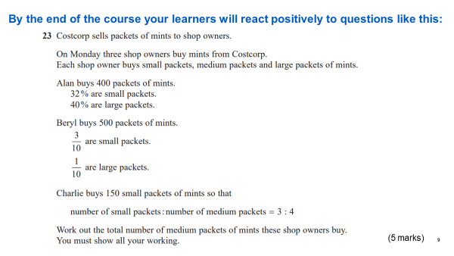
Reflections
Notes:
Reflect on what has been achieved since module 1 – this is the question displayed in that first module.
What approaches have been developed which mean this prediction was correct?

Slide 45

Note to your future self…
www.futureme.org
Notes:
One final activity.
Invite participants to scan the QR code, or visit the url https://www.futureme.org/ (no sign up needed, but a verification email will be sent to agree to receive the message).
The website allows you to send your future self a message!
Set the date for 3 months from now.
What do you hope to achieved by then?
If you don’t quite get there, the message will serve as memory jog.

Slide 46
08
Next steps
Notes:
Divider Slide

Slide 47
Teaching for Mastery in FE Maths
  Access the course materials: to be added
  Access to the CfEM Resources and Evidence Hub: https://www.et-foundation.co.uk/professional-development/maths-and-english/cfem/cfem-resources-and-evidence/

