Slide 1

Motivation and Engagement
Don’t get bamboozled!

Slide 2
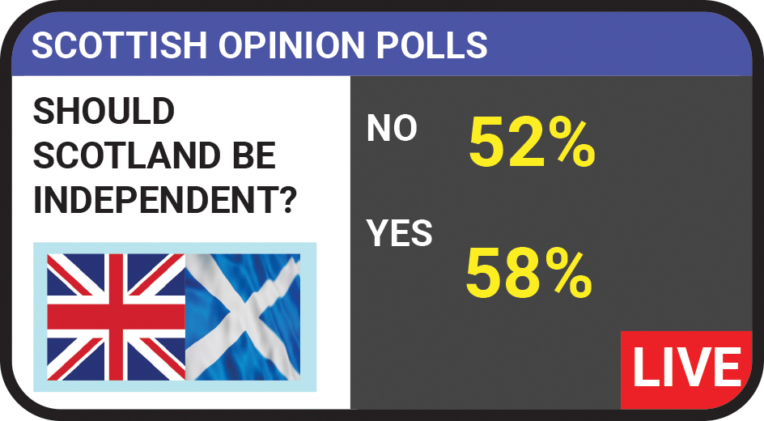
What is wrong with this?

Slide 3
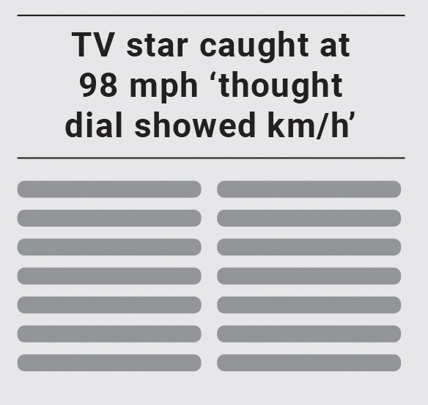
If the TV star had been travelling at 98 km/h, would he have been breaking the speed limit?

Slide 4

What is wrong with this? What should it say?

Slide 5
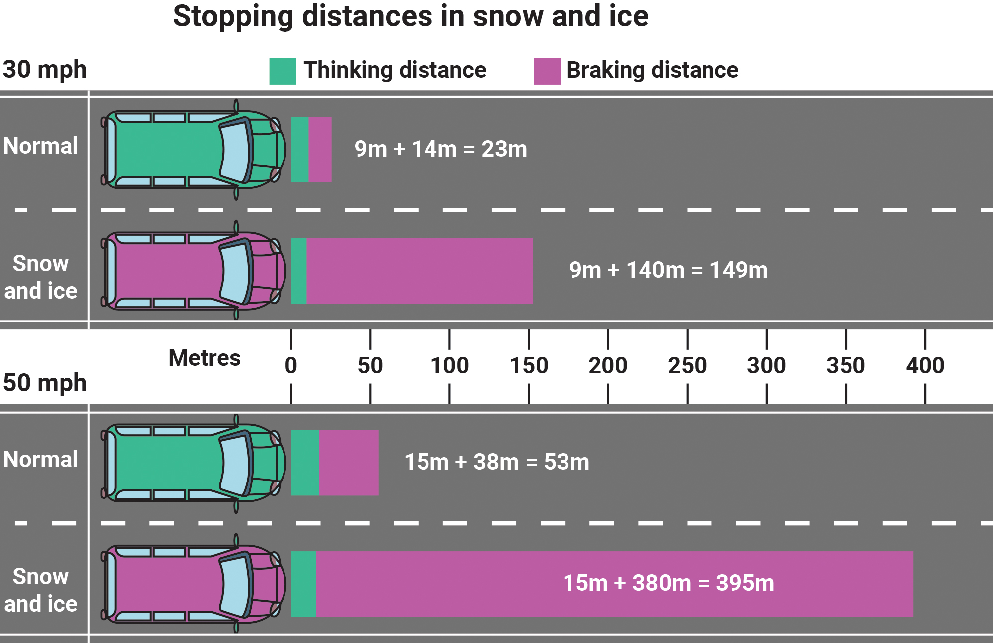
Do these diagrams make sense?
Notes:
Note: The cars are not drawn to scale.

Slide 6
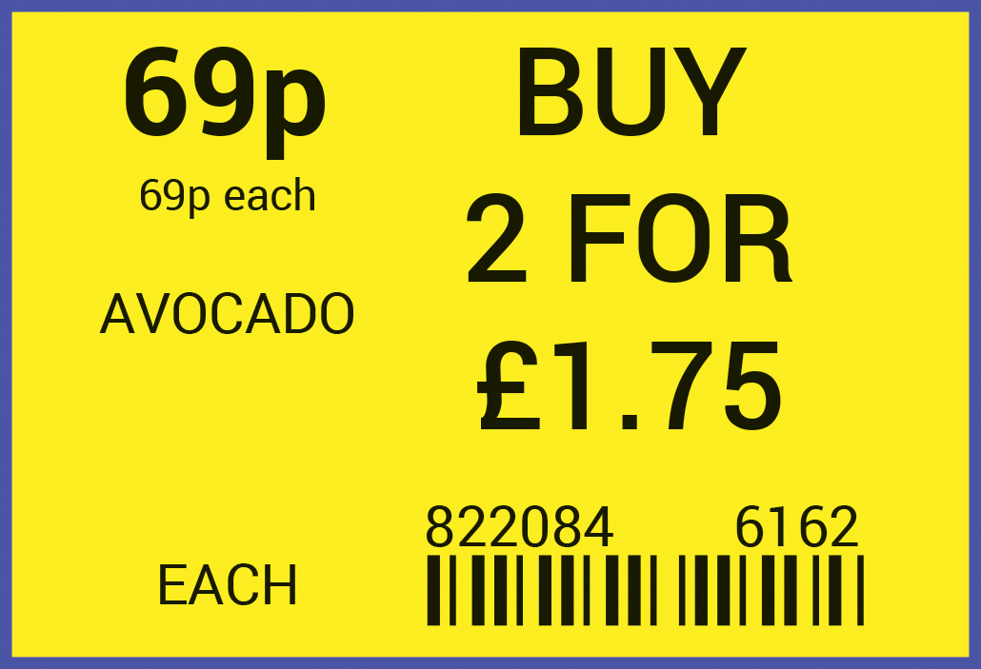
Is it worth buying two?

Slide 7

Comment on this.

Slide 8

Comment on this.

