Slide 1
Teaching for mastery in FE Maths
SLIDE TO BE UPDATED ACCORDINGLY THEN DELETE THESE BANNERS
Module 3 – Making sense of proportion
PRESENTER NAME
DATE AND TIME
SLIDE TO BE UPDATED ACCORDINGLY THEN DELETE THESE BANNERS

Slide 2
00
Gap task

Slide 3
Gap task to be completed before Module 3
Work through this question.
What different approaches can you use to solve it?
Em, Finch and Gill build a wall each.
Altogether they use 60 blocks.
Finch’s wall is twice as long as Em’s wall.
Gill’s wall is three times as long as Em’s wall.
How many bricks are in each of their walls?
How did you answer this question?

Slide 4
01
About this module

Slide 5
SLIDE TO BE UPDATED ACCORDINGLY THEN DELETE THESE BANNERS
Welcome and introductions
House-keeping, health/safety – populate with relevant info
Reminder - Reflective log
Reminder - Teaching for Mastery in FE Maths Padlet
SLIDE TO BE UPDATED ACCORDINGLY THEN DELETE THESE BANNERS
Notes:
Introductions- name and college
Reflective Log - (briefly) somewhere to make short notes about items they can take away and use.
Course Padlet - contains all module resources and also suggested further reading. Module 3 Padlet will be unlocked at the end of the module, or earlier if PD Lead wishes.

Slide 6
Reminder - Course structure
Module 1: Engagement and resilience
Module 2: Responsive teaching
Module 3: Making sense of proportion
Module 4: Working with manipulatives
Module 5: Getting "unstuck"- reasoning and problem solving
Module 6: Planning for learning

Slide 7
Aims
On completion of this module, participants will:
have familiarised themselves with the tools of bar models and ratio tables as an aid to understanding proportionality.
be aware that, once learners have understood these models, they are able to use them in a wide variety of topics.
Notes:
You may also want to mention that the use of models can help reduce cognitive load and therefore reduce the amount of working memory that is used.

Slide 8
Today’s schedule
SLIDE TO BE UPDATED ACCORDINGLY THEN DELETE THESE BANNERS
**:** Gap task
**:** About this module
**:** Where do we find proportion
**:** Research
**:** Ratio tables
**:** Break
**:** Bar Models
**:** Exam questions
**:** Next steps
**:** Close
PD Lead to replace asterisks with timings
SLIDE TO BE UPDATED ACCORDINGLY THEN DELETE THESE BANNERS

Slide 9
02
Where do we find proportion?

Slide 10
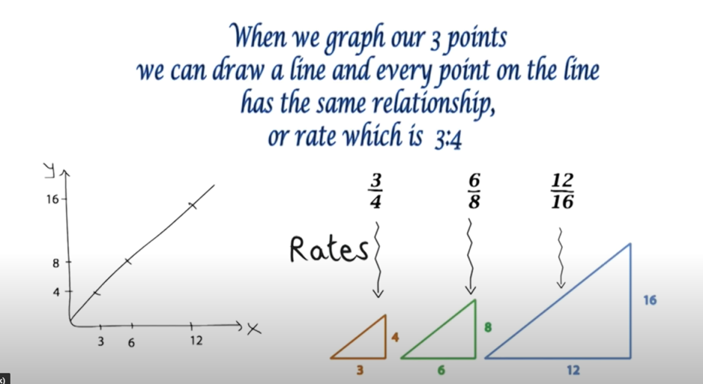
Gap task 2
What were your thoughts about this video?
https://www.youtube.com/watch?v=7FE_8wGgw_M
Notes:
Ask participants what they thought of the video. Try to tease out that it’s about making connections and how it reduces the amount of working memory that is used.
Probe for the key concept that underpins all the topics explored in the video – i.e. they are based around proportional reasoning.

Slide 11
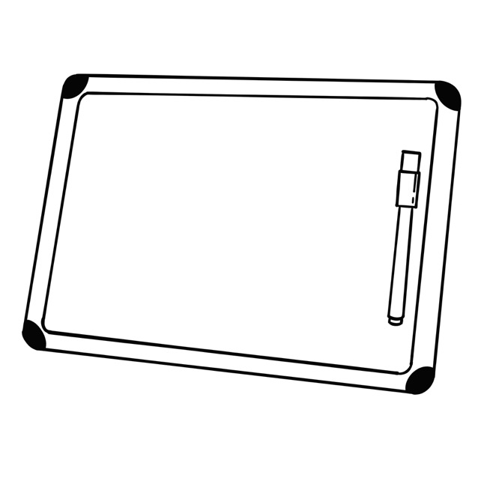
On Mini Whiteboards
What proportion of GCSE maths is proportion, ratio and rates of change?
Notes:
Image reference: Image by https://pixabay.com/users/audreyillustrations-12979416
Ask a quick question: what proportion of GCSE maths is proportion, ratio and rates of change? For Foundation Tier it’s 30%, but well above 50% when you look at other GCSE topic areas where it is present.
Do this as a show of hands. Suggest asking “Is it 15%?” or “20%?” or “25%?” or “30%?” or “35%?” or “50%?”

Slide 12
Misconceptions
What are some of the common mistakes or misconceptions that students make with ratio and proportion?
Notes:
Ask participants, in pairs or on their tables, to come up with misconceptions that students might have with ratio and proportion. Presenter circulates finding out what misconceptions participants come up with. Participants feedback their misconceptions to the whole group.

Slide 13
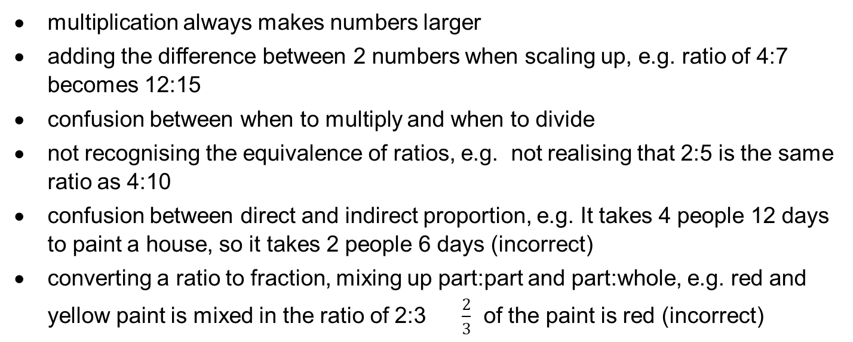
Some typical misconceptions
multiplication always makes numbers larger
adding the difference between 2 numbers when scaling up, e.g. ratio of 4:7 becomes 12:15
confusion between when to multiply and when to divide
not recognising the equivalence of ratios, e.g. not realising that 2:5 is the same ratio as 4:10
confusion between direct and indirect proportion, e.g. It takes 4 people 12 days to paint a house, so it takes 2 people 6 days (incorrect)
converting a ratio to fraction, mixing up part:part and part:whole, e.g. red and yellow paint is mixed in the ratio of 2:3 $\frac{2}{3}$ of the paint is red (incorrect)
Notes:
This is a list of the misconceptions that participants might come up. Are there any misconceptions that the group missed that you might want to highlight?
Presenter might mention some of the ideas below.
Each of these misconceptions could make a lesson in its own right.
Identifying misconceptions is key to planning for responsive teaching.
Exposing and addressing misconceptions helps support learners’ understanding.

Slide 14
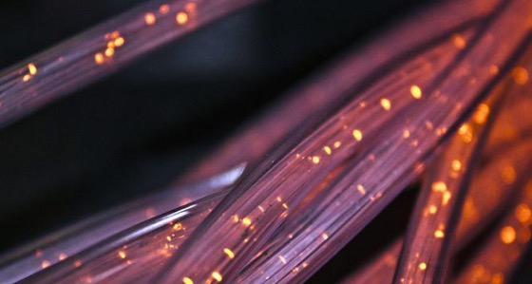
Cost of living: Broadband and phone rental bills
Bradley paid £99.96
Alaya paid £78
Kai paid £63.73
Michelle paid £108.00
Whose statement would you prefer?
Notes:
Image copyright: https://pixabay.com/photos/fiber-cable-wire-connection-4814456/
‘Whose statement would you prefer?’ is supposed to be a provocative question.
Looking at the information we have, it would be Kai.
Participants will hopefully say "You don’t know how long the statement was for" and "You don’t know if the rate is constant".

Slide 15
Cost of living: Broadband and phone rental bills
How much paid | Period of invoice
Bradley paid £99.96 | 4 months
Alaya paid £78 | 3 months
Kai paid £63.73 | 2.5 months
Michelle paid £108.00 | 6 months
Whose statement would you prefer now?
Notes:
Circulate and see how participants have answered.

Slide 16
Cost of living: Broadband and phone rental bills
How much paid | Period of invoice
Bradley paid £99.96 | 4 months
Alaya paid £78 | 3 months
Kai paid £63.73 | 2.5 months
Michelle paid £108.00 | 6 months
Now answer this in a different way.
Notes:
Now participants have more information, ask them to answer this in 2 different ways.
Ask them to consider which of their methods is the more formal or informal.

Slide 17
03
What the research says

Slide 18
The RME models associated with the number module - i.e., the bar model and the ratio table - were shown to be particularly useful for GCSE resit students. They provided them with a new way of representing and thinking about a variety of familiar problems; they promoted informal strategies which can be very helpful to students………………They unify many elements of the number curriculum, which is particularly important within the confines of a short course. (Hough and Solomon, 2017)
Action research by CfEM colleges supports this, consistently showing that bar models and ratio tables work with FE maths learners.
Double number lines have also been used effectively and are worth investigating further.
Notes:
Hough and Solomon (2017), ‘Investigating the impact of a Realistic Mathematics Education approach on achievement and attitudes in Post-16 GCSE resit classes’
RME closely aligned with mastery.
Key messages to get across from this research:
Ratio tables and bar models allow students to work more informally - they don’t need to remember multiple methods, thus reducing cognitive load
Ratio tables and bar models can be used as models in a variety of contexts
In RME, models are derived from the context. For example, if a ribbon is cut into equal lengths, the ribbon can be drawn as a bar and the model arises from the context. As students progress they can use bar models to represent other situations.

Slide 19
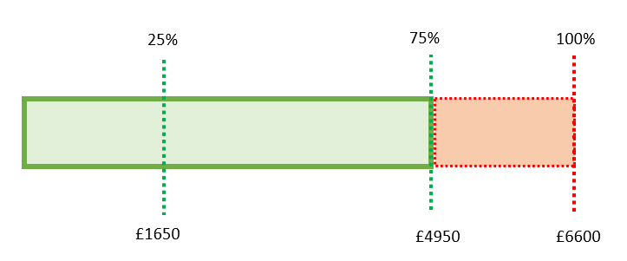

During a one year period Indra’s investment reduced by 25% to £4950.
How much was Indra’s investment at the start of the year?
Notes:
This is an example of a ratio table and bar model used with a reverse percentage question, for teachers who might not have heard of them or used them.

Slide 20
Feedback from Centres
Don’t rush it: teachers need CPD and time to practice
More marked impact on the success of Grade 1 and 2 students
Grade 3 learners did start to use bar model / ratio tables for the more difficult questions
Ratio tables have been used successfully at a number of colleges with vocational teachers and their students
Notes:
Important to note that teachers need to practise and master new ideas. Students need to be supported in use of new models.
Action research from CfEM shows that models have an effect on all learners including grade 3s, but the greatest impact is on grade 1 and grade 2 students.

Slide 21
PD lead slide
You can choose to do bar models before ratio tables - it doesn’t matter which you do first
Make your choice on your personal preference or the context of your participants
Notes:
It’s possible that ratio tables might be completed in less than 45 minutes, giving more time for bar models.

Slide 22
04
Ratio Tables

Slide 23
Where do we find proportional reasoning in GCSE maths or functional maths?
In which topics does proportional reasoning occur in addition to proportion, ratio and rates of change?
Notes:
Ask participants
Where do we find proportional reasoning in GCSE maths or functional maths?
In what topics does proportional reasoning occur, in addition to proportion, ratio and rates of change?
PD Lead to ask for quick fire responses. PD Lead to record responses on flip chart or whiteboard.
Purpose is for participants to realise just how much of Level 1 & 2 maths is to do with making sense of proportion.

Slide 24
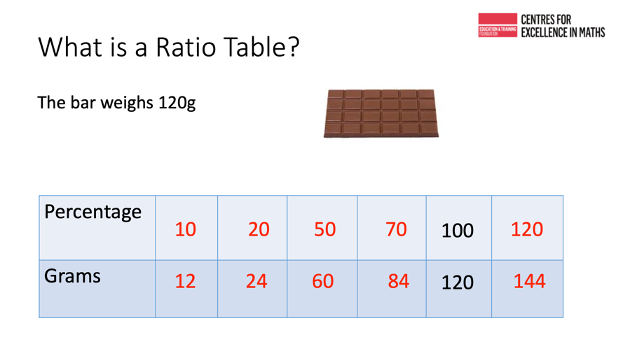
Video of ratio table
https://youtu.be/DWtXTJJwORA
Notes:
https://youtu.be/DWtXTJJwORA
Play video and pause at 1 min 35 sec to compare the list of where Proportion is found and where Byron is saying ratio tables can be used in GCSE Maths and FSM.
Play video to the end.
Ask participants for their thoughts on the video.
Remember Byron is a teacher from one of the CfEMs. This gives credibility for using ratio tables with learners.
Download video in advance to avoid problems with streaming during the session.

Slide 25
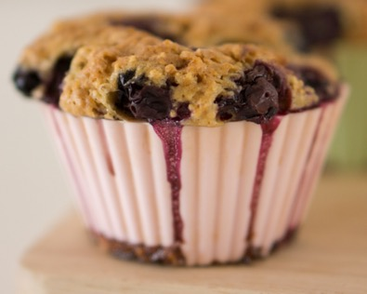
Recipe for 12 Blueberry muffins.
108g butter
140g golden caster sugar
2 large eggs
140g natural yogurt
1 tsp vanilla extract
2 tbsp milk
250g plain flour
2 tsp baking powder
1 tsp bicarbonate of soda
125g pack blueberries
Stanislaw has 175g of butter.
Does Stanislaw have enough butter to make 20 blueberry muffins?
Muffins | 12
Butter (g) | 108
Notes:
Image copyright https://pixabay.com/photos/blueberry-muffins-close-up-cooking-1839252/
This question can be modelled on the PPT slides, but is much more dynamic if you ask people to come up with their own approaches and model on a whiteboard as a whole group.
Starting with 12 and 108, where would you go from here?
People might divide by 2, 3, 4, 6 or 12.
There are many ways that a ratio table like this can be used.
The important thing is that students get to choose what they do.
They might divide by 2 and use 6 by adding 6 until they get to 18.
Lots of learners are able to do multiplication as repeated addition, i.e. 6 + 6 + 6 = 18. Though this is less efficient than 3 x 6, it will nevertheless enable learners to use what they know and help them progress to more efficient methods.
Slides 26 to 28 are hidden. They are not to be used with participants but might be an aid to understanding for PD Leads.
.

Slide 26
Recipe for 12 Blueberry muffins.
108g butter
140g golden caster sugar
2 large eggs
140g natural yogurt
1 tsp vanilla extract
2 tbsp milk
250g plain flour
2 tsp baking powder
1 tsp bicarbonate of soda
125g pack blueberries
Stanislaw has 175g of butter.
Does Stanislaw have enough butter to make 20 blueberry muffins?
Muffins | 12 | 4
Butter (g) | 108 | 36
Notes:
Image copyright https://pixabay.com/photos/blueberry-muffins-close-up-cooking-1839252/
This slide is hidden and can be used as an example to support the PD lead

Slide 27
Recipe for 12 Blueberry muffins.
108g butter
140g golden caster sugar
2 large eggs
140g natural yogurt
1 tsp vanilla extract
2 tbsp milk
250g plain flour
2 tsp baking powder
1 tsp bicarbonate of soda
125g pack blueberries
Stanislaw has 175g of butter.
Does Stanislaw have enough butter to make 20 blueberry muffins?
Muffins | 12 | 4 | 8
Butter (g) | 108 | 36 | 72
Notes:
Image copyright https://pixabay.com/photos/blueberry-muffins-close-up-cooking-1839252/
This slide is hidden and can be used as an example to support the PD lead

Slide 28
Recipe for 12 Blueberry muffins.
108g butter
140g golden caster sugar
2 large eggs
140g natural yogurt
1 tsp vanilla extract
2 tbsp milk
250g plain flour
2 tsp baking powder
1 tsp bicarbonate of soda
125g pack blueberries
Stanislaw has 175g of butter.
Does Stanislaw have enough butter to make 20 blueberry muffins?
Muffins | 12 | 4 | 8 | 20
Butter (g) | 108 | 36 | 72 | 180
Notes:
Image copyright https://pixabay.com/photos/blueberry-muffins-close-up-cooking-1839252/
This slide is hidden and can be used as an example to support the PD lead

Slide 29
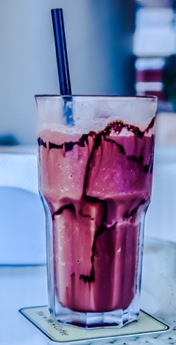
Liz is making a milkshake and follows these instructions.
Mix together
5 parts of milk and
2 parts of blackcurrant juice
Liz has 300ml of milk and 200ml of blackcurrant juice.
What is the greatest amount of milkshake that Liz can make?
Milk (ml)
Blackcurrant juice (ml)
Notes:
Image copyright: https://pixabay.com/photos/table-drink-glass-milkshake-cold-3139815/
Participants answer this question individually using a ratio table and then their approaches are compared.
Slides 30 to 36 are hidden. They are not to be used with participants but might be an aid to understanding for PD leads.

Slide 30
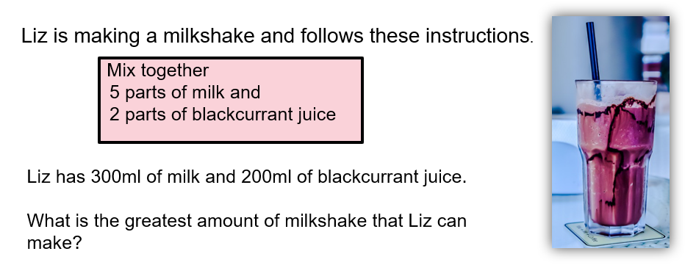
Milk (ml) | 5
Blackcurrant juice (ml) | 2
Notes:
Image copyright: https://pixabay.com/photos/table-drink-glass-milkshake-cold-3139815/
This slide is hidden and can be used as an example to support the PD lead to do the task and not to be used with participants

Slide 31
Milk (ml) | 5 | 10
Blackcurrant juice (ml) | 2 | 4
Notes:
Image copyright: https://pixabay.com/photos/table-drink-glass-milkshake-cold-3139815/
This slide is hidden and can be used as an example to support the PD lead

Slide 32
Milk (ml) | 5 | 10 | 100
Blackcurrant juice (ml) | 2 | 4 | 40
Notes:
Image copyright: https://pixabay.com/photos/table-drink-glass-milkshake-cold-3139815/
This slide is hidden and can be used as an example to support the PD lead

Slide 33
Milk (ml) | 5 | 10 | 100 | 300
Blackcurrant juice (ml) | 2 | 4 | 40 | 120
Notes:
Image copyright: https://pixabay.com/photos/table-drink-glass-milkshake-cold-3139815/
This slide is hidden and can be used as an example to support the PD lead

Slide 34
Milk (ml) | 5
Blackcurrant juice (ml) | 2
Notes:
Image copyright: https://pixabay.com/photos/table-drink-glass-milkshake-cold-3139815/
This slide is hidden and can be used as an example to support the PD lead

Slide 35
Milk (ml) | 5 | 50
Blackcurrant juice (ml) | 2 | 20
Notes:
Image copyright: https://pixabay.com/photos/table-drink-glass-milkshake-cold-3139815/
This slide is hidden and can be used as an example to support the PD lead

Slide 36
Milk (ml) | 5 | 50 | 500
Blackcurrant juice (ml) | 2 | 20 | 200
Notes:
Image copyright: https://pixabay.com/photos/table-drink-glass-milkshake-cold-3139815/
This slide is hidden and can be used as an example to support the PD lead

Slide 37
Student work using a ratio table

Slide 38
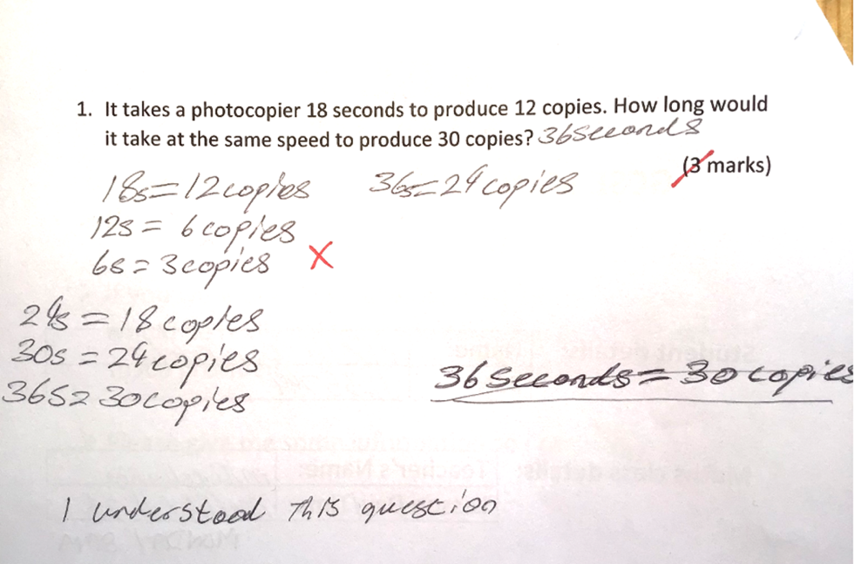
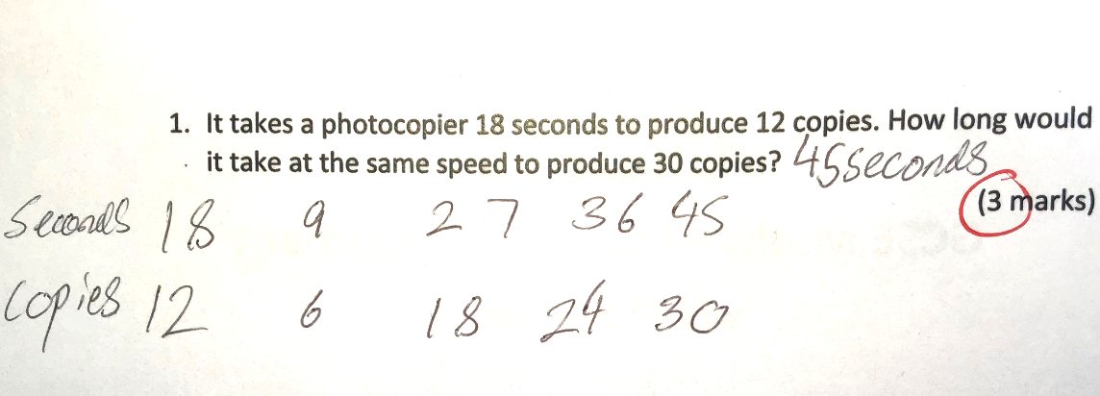
Notes:
Same question, same student. Compare responses before and after the student was introduced to ratio tables (Michael Lancaster, Harlow College). Ask participants to analyse where the student went wrong in the first example.

Slide 39
Features of Ratio Table
Gives a structure to get started
Utilises learner skills of halving, doubling, powers of ten
Makes use of equivalence
Can be used with many topic areas
Learners who can’t confidently use multiplication can use addition
It’s informal
Uses knowledge of number system and helps build reasoning with understanding.
Notes:
Ratio tables generally work best if they are horizontal, as we read left to right. However, they may work better vertically for some learners.
Ratio tables reduce the load on working memory.
Ratio tables have many uses. Here are some. The list is not exhaustive:
ratio
multiplication & division (including long & short)
speed, distance, time
density
rates
proportion
pie charts
enlargement
conversions
equivalent fractions
percentages
best buy
scale drawing
Further reading on ratio tables:
https://rme.org.uk/getting-started/working-with-rme-materials-using-models/the-ratio-table/
https://thirdspacelearning.com/blog/ratio-table/
Interactive online ratio tables:
https://mathsbot.com/activities/missingFDPGrid
https://mathsbot.com/activities/missingFDPGrid

Slide 40
Practice ratio tables
Working in pairs, have a go at some of the questions using ratio tables
What are the benefits of using ratio tables with your learners?
Prepare to feedback from your group key points about using ratio tables
Notes:
RESOURCE HANDOUTS 3.4 AND 3.5
Utilise participants that have experience of ratio tables to support others.
Depending on the skills levels and experience of ratio tables you will get a variety of responses.

Slide 41
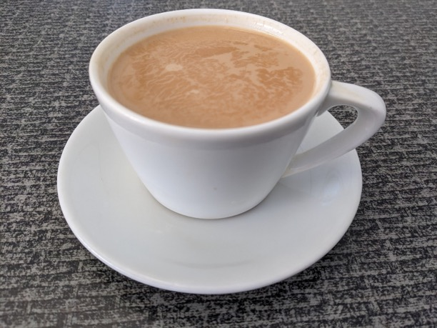
Break

Slide 42
05
Bar modelling

Slide 43
28 ÷ 4
28
14
14
7
7
7
7
Notes:
Use this slide to demonstrate how a bar model can be used for a simple division problem, and demonstrates how bar models can be used for all levels of calculation and problems – from basic to complex.

Slide 44
12 × 7
12
12
12
12
12
12
12
24
24
24
12
48
36
84
Notes:
This slides shows the use of a bar model for simple multiplication.

Slide 45
Answer this problem using bar models
April, Richard and Usha each competed in a maths competition.
Richard’s score was four times April’s.
Usha’s score was half of Richard’s score.
What is the ratio of April’s score to Richard’s score to Usha’s score?
Notes:
First of two problems to solve using a bar model.

Slide 46
April, Richard and Usha each competed in a maths competition.
Richard’s score was four times April’s.
Usha’s score was half of Richard’s score.
What is the ratio of April’s score to Richard’s score to Usha’s score?
April’s score
Richard’s score
Usha’s score
Notes:
Bars animated to show thinking process. Answer 1:4:2

Slide 47

















Usha scored 78 points. How many points did April score?
𝐴
117
$$117 ÷3=39$$
$$A$$
39
$$R$$
39
39
39
$$39 ×2 =78$$
$$78 ÷2=39$$
$$R$$
$$U$$
39
39
Usha’s score is 78
April’s score is 39
$$U$$
39
39
78
Richard scored 117 points more than April. How many points did Usha score?
78
April, Richard and Usha each competed in a maths competition.
Richard’s score was four times April’s.
Usha’s score was half of Richard’s score.
The total points scored by April, Richard and Usha is 273. How many more points did Richard score than Usha?
Richard scored 156 points. Find the mean, mode, median and range of the 3 competitors.
$$273 ÷7=39$$
$$156 ÷4=39$$
𝐴
$$39 ×4 =156$$
$$39 ×7 =273$$
39
𝐴
$$39 ×2=78$$
$$273 ÷3=91$$
𝑅
39
39
39
273
$$156 −78 =78$$
𝑅
39
Mean = 91 points
Richard scored 78 more than Usha
Median = 78 points
No Mode
$$U$$
39
39
$$U$$
Range = 117
Notes:
This slide shows how a bar model can make a complex question easily accessible through a visual representation.
Show the 4 questions without the bar models. Ask participants to work on questions for one minute. Then reveal the bar models. Ask participants to work on the questions using the bar model.
Stop participants working after about 2 minutes.
Ask participants which method of working they found easiest. Anticipate that they will see that the bar model visual representation will have made questions easier to answer. Participants may say that they did it algebraically and that having written $A=A, R=4A, U=2A$ makes it easier as you don’t have to draw anything. You could ask “Which method might learners find easiest and prefer?”
Allow participants time to have a go at completing the questions using bar modelling, then show the animations on this slide. They follow a structured and consistent way of bar modelling.
The activity is based on procedural variation. It is worth highlighting this to participants as the situation of the maths competition doesn’t alter, but the questions do alter slightly. Procedural variation can help learners to identify connections and structure.
The questions are intentionally in no particular order. When learners are tackling these questions it is fine for them to do them in any order.
Participants might comment that this context isn’t a realistic context. On the surface this looks like a realistic context. However, it isn’t really a believable context, it is a pseudo context as it is unlikely that Richard and Usha’s scores would be 4 times and twice April’s respectively.
The activity could easily draw out misconceptions. Drawing out misconceptions from the activity will enable teachers to respond to needs of individuals and the whole class.
Some misconceptions that might emerge:
Richard’s score is 156 points. Learners might divide by 7 parts (all 3 competitors), rather than 4 parts (Richard’s share)
Find the mean by dividing 7 parts by 3
Median is 156. Richard is middle value on bar model and in written order in question.
Mode is 156 or Richard as there are more bars on bar model and might be mistaken due to having similar looks to a bar chart.

Slide 48
Answer this problem using bar models
Roger baked some cakes for the college fair. He sold ³⁄₅ of them in the morning and ¹⁄₄ of what was left in the afternoon.
If he sold 300 more cakes in the morning than in the afternoon, how many cakes did he bake?
Notes:
Allow participants time to struggle working on this using bar models

Slide 49

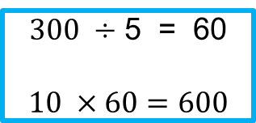
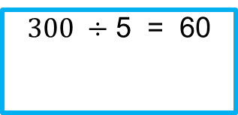
Roger baked some cakes for the college fair. He sold ³⁄₅ of them in the morning and ¹⁄₄ of what was left in the afternoon.
If he sold 300 more cakes in the morning than in the afternoon, how many cakes did he bake?
Morning
Afternoon
Sold
Sold
Sold
Sold
60
60
60
$300 ÷$ 5 = 60
$$10 ×60=600$$
60
60
Morning
$300 ÷$ 5 = 60
Afternoon
300
Notes:
Here is one way that bar models could be used to solve this problem.
Ask for a volunteer to talk their way through the animation, giving clear explanations and reasoning.

Slide 50
Student work using a bar model

Slide 51
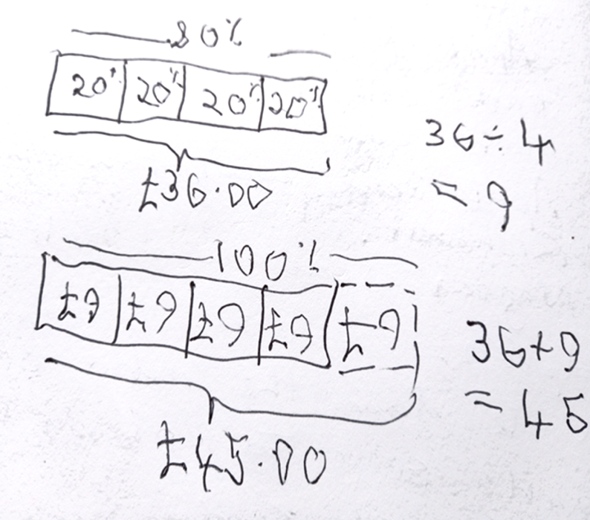
A shirt was reduced in a sale by 20% and now costs £36.00.
What was the original cost of the shirt?

Slide 52
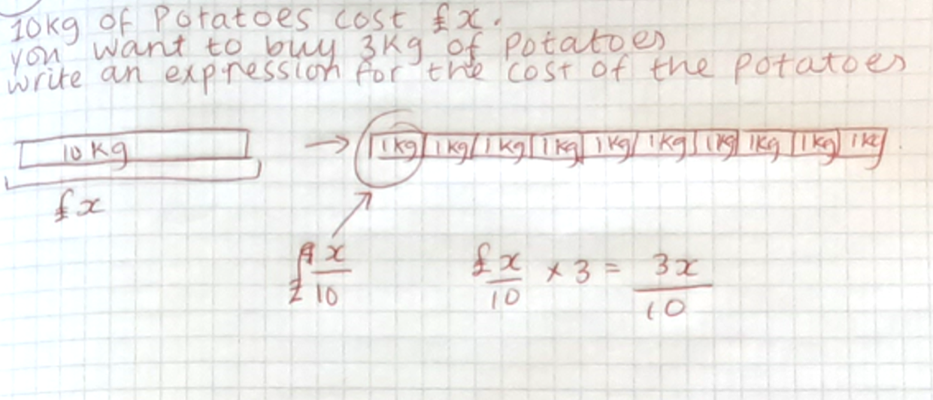

Slide 53
Features of Bar Model
Uses visual representation by use of a rectangle or blocks to model a situation
Different ways of setting up a bar model. May be vertical or horizontal and labelling may vary
Can be used in algebra and many other topics
Informal approach.
Notes:
Bar models may be used in a variety of situations, there isn’t one correct way or method
Bar models can be used for many uses, and this reduces the load on working memory.
Bar models have many uses, here are some, though not exhaustive: (Anywhere where 2 or more quantities are in direct proportion)
ratio
addition & subtraction
multiplication & division (including long & short)
proportion
conversions
equivalent fractions
fractions
decimals
percentages
best buy
solving equations
Further reading for bar models
https://rme.org.uk/getting-started/working-with-rme-materials-using-models/the-bar-model/
https://www.ncetm.org.uk/classroom-resources/ca-the-bar-model/
Interactive online bar models:
https://mathsbot.com/manipulatives/bar

Slide 54
Practice bar models
Have a go at the bar model questions
Answer using bar models
Consider how your learners would manage using bar models
Notes:
RESOURCE HANDOUTS 3.6 AND 3.7
Encourage participants to work in pairs.
Depending on time, you may want to let participants continue.
You may want them to share on their tables and then share with the whole group.
Use your judgement on how participants have handled using bar models.
Ask participants how they think bar models would work with their learners.
Utilise participants that have experience of bar models to support others.

Slide 55
06
Modelling with exam questions

Slide 56
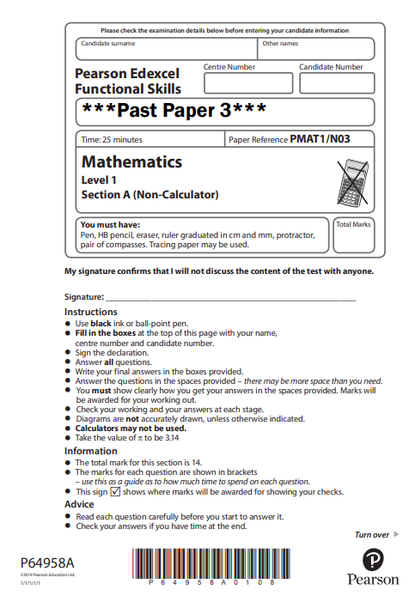
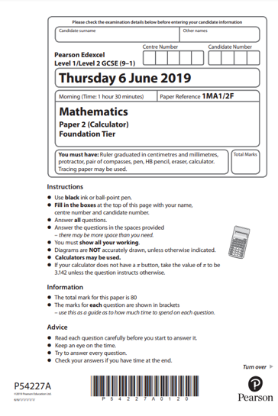
Modelling with exam questions
Get into groups of 4
Each group will work with half of a GCSE paper or FM L1 paper
Identify questions on your paper where a ratio table and/or a bar model could be used to help answer the question.
Notes:
RESOURCE HANDOUTS 3.8 TO 3.12
Each group of 4 will choose to work with half of a GCSE paper or FS paper. Tell participants to identify questions where a ratio table/bar model could be used. They are NOT being asked to answer the question.
Aim here is for participants to see how ratio tables and bar models can be used in an exam paper.
If possible, use a visualiser to review this activity, so that participants can see which question is being reviewed.
The selected papers are Edexcel papers. You may wish to use papers from another awarding body.

Slide 57
07
Review and next steps

Slide 58
When will you do it?
Where could you plan to use bar models and ratio tables in your teaching?
How do you feel about ratio tables and bar modelling?
What will you do?
Notes:
Participants will be at different stages of confidence and competence.
Participants may:
want to hone their own skills before going public
choose a class to work on questions on ratio tables
decide that they are going to introduce bar models to their own team.

Slide 59
Gap task between Modules 3 and 4
(Essential) Watch this video “What we’ve got wrong about learning mathematics” https://www.youtube.com/watch?v=-Gajs_UNItU
(Optional) – Simultaneous equations for reception children (minutes 13 to 17 approx.) https://www.youtube.com/watch?v=TvcM7GnY61U
Notes:
Teachers watch this TED talk, make a note of their responses to the questions on the next slide and bring them to the Module 4 to share. The TED talk is mostly schools focused but there is much in it of relevance to FE.
The second optional clip is short but thought provoking and fits nicely in with the content of Module 4.

Slide 60
Gap task between Modules 3 and 4
As you watch, make a note of your responses to the questions below. The TED talk by Alf Coles is mostly schools focussed, but there is much in it of relevance to FE.
What surprised you?
What interests you?
What you agree with?
What you disagree with?
Anything else?
Bring your notes to Module 4 to share.

Slide 61
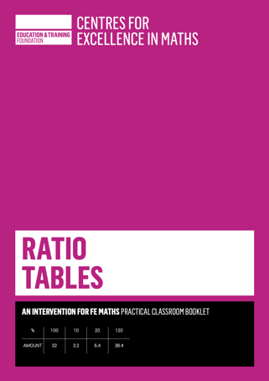

Further CfEM resources on ratio tables, bar models and double number lines
Ratio tables: an intervention for FE maths
Bar models: an intervention for FE maths
Using visual models and representations
CfEM action research reports (scroll to FE Mastery Models)

