Slide 1
Teaching for Mastery in FE Maths
SLIDE TO BE UPDATED ACCORDINGLY THEN DELETE THESE BANNERS
Module 2 – Responsive Teaching
PRESENTER NAME
DATE AND TIME
SLIDE TO BE UPDATED ACCORDINGLY THEN DELETE THESE BANNERS

Slide 2
01
Pre-session task review
Notes:
Divider Slide

Slide 3

Pre-session task review
The pre-session task asked you to read a blog post on Diagnostic and Responsive teaching.
On your tables, discuss:
  What did you notice?
  What did you wonder?
  What are your opinions?

Slide 4
02
Aims and schedule
Notes:
Divider Slide

Slide 5
Course structure
Module 1: Engagement and resilience
Module 2: Responsive teaching
Module 3: Making sense of proportion
Module 4: Working with manipulatives
Module 5: Getting "unstuck"- reasoning and problem solving
Module 6: Planning for learning

Slide 6
Today’s schedule
SLIDE TO BE UPDATED ACCORDINGLY THEN DELETE THESE BANNERS
**:** Pre-session task review
**:** Aims, schedule and housekeeping
**:** Exploration of Responsive Teaching
**:** Comfort break
**:** Effective use of questions
**:** Next steps
**:** Close
SLIDE TO BE UPDATED ACCORDINGLY THEN DELETE THESE BANNERS
Notes:
To be updated by leader of PD, and yellow parts removed.
Please insert appropriate timings.

Slide 7
Aims of Module 2
On completion of this module, participants will have:
  a clear understanding of a responsive teaching approach in the FE maths classroom
  a bank of strategies to employ in lessons which will help identify students’ misconceptions
Notes:
Aims of the session to be shared with participants.

Slide 8
Housekeeping
SLIDE TO BE UPDATED ACCORDINGLY THEN DELETE THESE BANNERS
This slide to be populated with housekeeping and health/safety information
SLIDE TO BE UPDATED ACCORDINGLY THEN DELETE THESE BANNERS
Notes:
To be updated by deliverer of PD, and yellow parts removed.

Slide 9
03
What is responsive teaching?
Notes:
Divider Slide

Slide 10
Mentimeter
SLIDE TO BE UPDATED ACCORDINGLY THEN DELETE THESE BANNERS
Tell us what you understand by the term
RESPONSIVE TEACHING
using up to 3 words/phrases
UPDATE SLIDE WITH MENTI CODE
SLIDE TO BE UPDATED ACCORDINGLY THEN DELETE THESE BANNERS
Notes:
Gathering of thoughts and understandings before comparison with Centres and Literature.
PD Lead will need to create own Mentimeter poll for this section.
Feedback to the participants, using the word cloud function.

Slide 11
Responses from the Centres for Excellence in Maths
Formative Assessment
Building Confidence
Awareness
Timely
Flexibility
Learner focused
Misconceptions
Assessing usefully
Ongoing
usefully
Notes:
Triangulation of thoughts. This slide represents an overview of Centre Lead’s thoughts about responsive teaching.
Slide animates the thoughts, one by one.
The three larger comments are most interesting, especially the addition of the word USEFULLY within assessment, and should be emphasised with participants.
This will link to quotes in the next few slides.

Slide 12
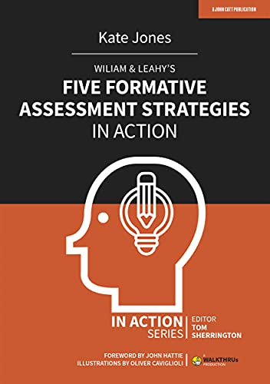
KATE JONES
WILIAM AND LEAHY’S FIVE FORMATIVE ASSESSMENT STRATEGIES IN ACTION, 2021
“…during the learning process, formative assessment can identify students’ progress as well as highlighting gaps in their knowledge and understanding to give the teacher useful insight as to what feedback and instruction can be provided…”
Notes:
This section gives quotes from a few leading thinkers on Formative Assessment and Responsive Teaching.
Point to highlight: GAPS IN THEIR KNOWLEDGE AND UNDERSTANDING
RESOURCE 2.4 HANDOUT (All 4 quotes)
Each quote can be displayed (slides 12, 13, 14 and 15) in turn as the participants give feedback and discuss.

Slide 13

DYLAN WILIAM AND PAUL BLACK
INSIDE THE BLACK BOX, 1998
“Teachers need to know about […] progress and difficulties with learning so that they can adapt their work to meet their needs”
Notes:
This section gives quotes from a few leading thinkers on Formative Assessment and Responsive Teaching.
Point to highlight: teachers ADAPT THEIR WORK
Seminal text – this started AfL. Dylan Wiliam has said that he couldn’t use the term formative assessment as he might have liked because of the university usage of the term linked to practice assessments. Having a “formative” at university has a completely different meaning to assessing formatively during teaching.
RESOURCE 2.4 HANDOUT (All 4 quotes)

Slide 14
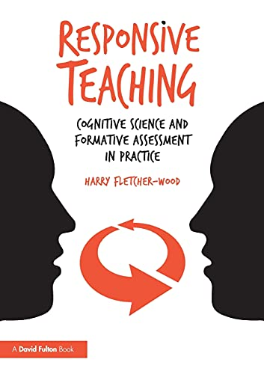
DYLAN WILIAM in RESPONSIVE TEACHING by Harry Fletcher-Wood, 2018
“We wanted […] to point out that the most important assessments happened during the teaching, not after it”
Notes:
This section gives quotes from a few leading thinkers on Formative Assessment and Responsive Teaching.
Point to highlight: DURING THE TEACHING
RESOURCE 2.4 HANDOUT (All 4 quotes)

Slide 15
HARRY FLETCHER-WOOD
RESPONSIVE TEACHING, 2018
“Responsive teaching blends planning and teaching, based on an understanding of how students learn […] with formative assessment to identify what students have learned and adapt accordingly”
Notes:
This section gives quotes from a few leading thinkers on Formative Assessment and Responsive Teaching.
A definition here.
What do participants think of this definition?
RESOURCE 2.4 HANDOUT (All 4 quotes)

Slide 16
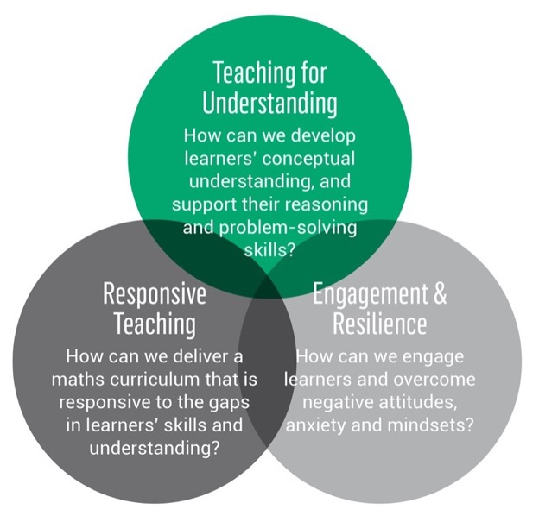
Reminder - key principles & key questions
Relates to Key principle 5.
Teaching that allows students to develop an understanding of mathematical structure.
Valuing and building on students’ prior learning.
Prioritising curriculum coherence and connections.
Developing both fluency and understanding of key ideas.
Developing a culture in which everyone believes everyone can succeed.
Relates to Key principles 2 & 4.
Relates to Key principles 1,3 & 4.
Notes:
Reinforcement of the three key questions and five key principles for mastery teaching, as outlined in the pre-course screencast.

Slide 17
04
Connections
Notes:
Divider slide.

Slide 18
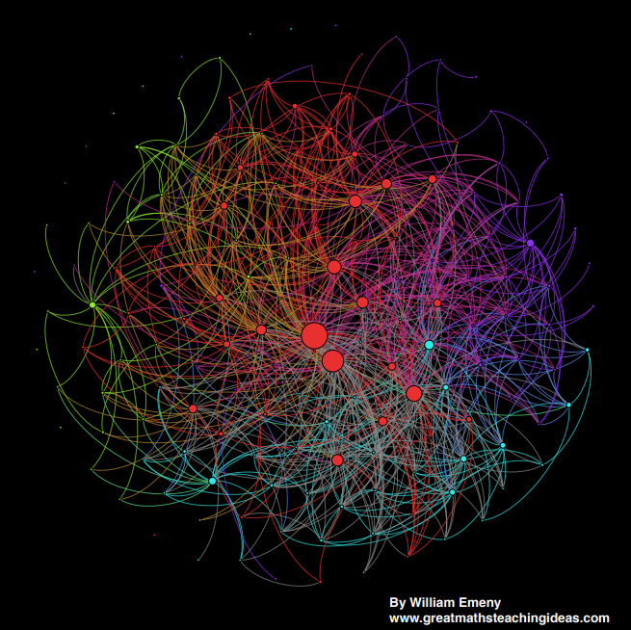
Mathematical connections and misconceptions
Notes:
Popular image from 2014 showing how concepts in maths are interconnected. Please note that this website no longer exists.
What would happen if a connection broke? Or connected to somewhere it shouldn’t?
This is where identifying mathematical connections and misconceptions for topics can help students learn. Teachers can guide them to fix any gaps or wrong connections.
Notice that there are only a few nodes around the edge that are not connected to others. These tend to be linked to definitions of vocabulary.
There is a link here to Richard Skemp’s work on Relational/Instrumental understanding.
“Skemp identifies two primary approaches to maths: Instrumental and Relational. Instrumental mathematics centres around rote learning, memory, rules and correct answers. Relational mathematics focuses more on establishing connections, building understanding over time, applying concepts to other problems, and gradual increases in complexity. In reality, an effective maths lesson calls for a bit of each approach. However, an emphasis on the Relational approach leads pupils to a deeper understanding of maths, and a boosted confidence in the long run.”
(from: https://mathsnoproblem.com/blog/teaching-practice/understanding-relational-and-instrumental-mathematics/)

Slide 19
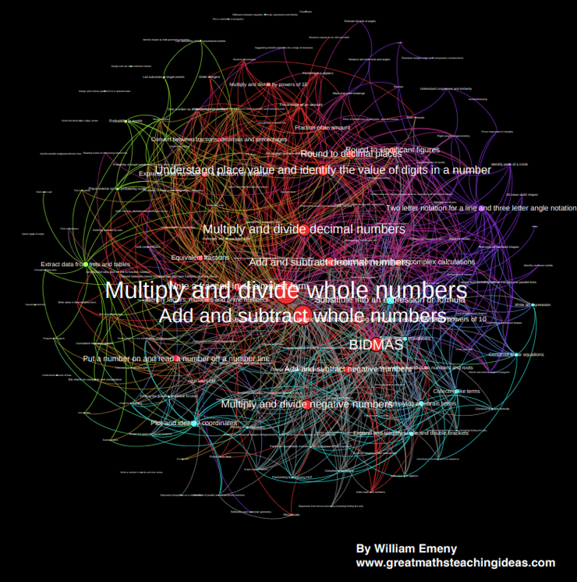
Mathematical connections and misconceptions
Notes:
Popular image from 2014 showing how concepts in maths are interconnected. Please note that this website no longer exists.
Same image showing topics which are connected most frequently.

Slide 20
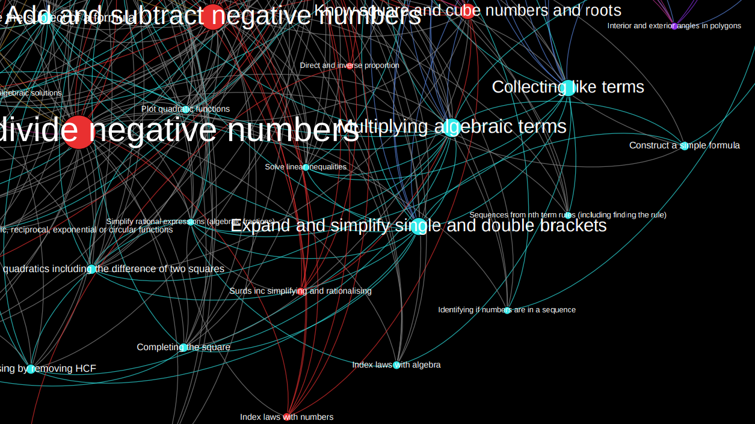
Mathematical connections and misconceptions
Notes:
Popular image from 2014 showing how concepts in maths are interconnected. Please note that this website no longer exists.
Magnified image of part of previous slide.

Slide 21
Mathematical connections and misconceptions
CO-ORDINATES
Step 1 - Connections
Notes:
ACTIVITY STEP 1: What prior knowledge is needed? Where could solid co-ordinates knowledge take students next? (Journey of the topic through maths)
PD lead to model the thinking behind a forensic examination of Co-ordinates (participants will copy the method shortly)
On a class whiteboard, lead the participants through producing a spider diagram for co-ordinates.
It’s important that any connections are authentic – don’t force links where they don’t happen naturally.
Connections should link to PRIOR LEARNING and STRETCH/CHALLENGE as well as other topic areas.

Slide 22
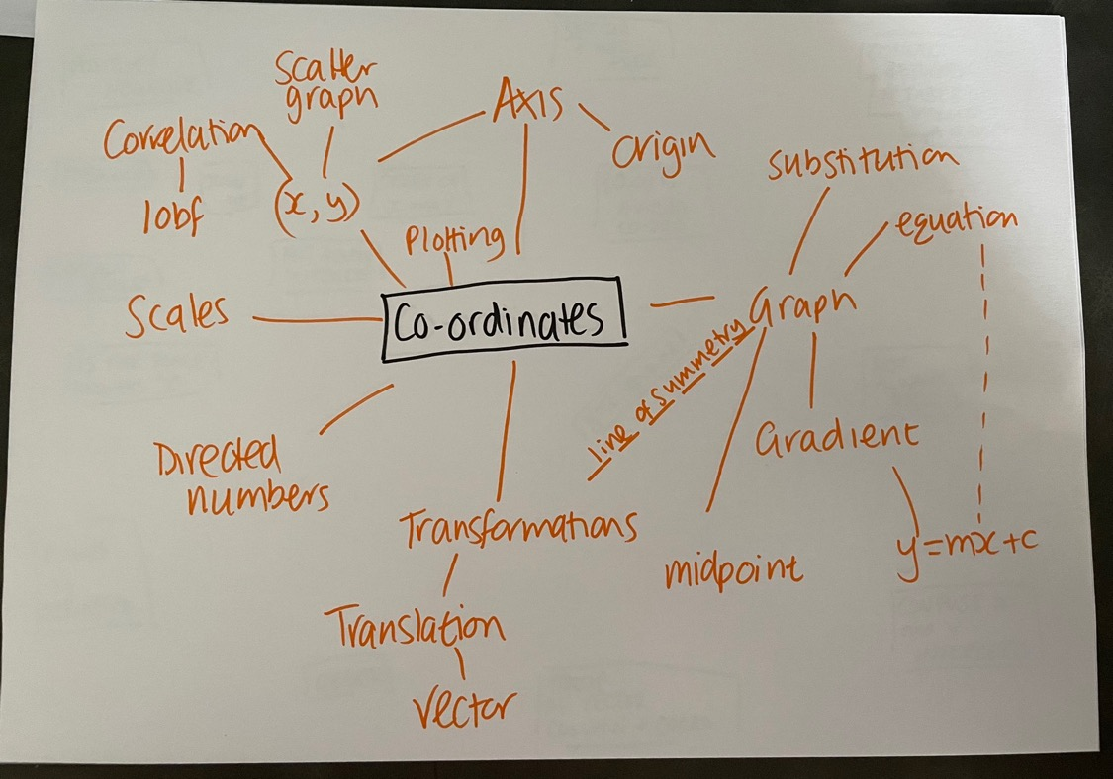
Notes:
HIDDEN SLIDE WITH EXAMPLE.
Not exhaustive! Orange = connections

Slide 23
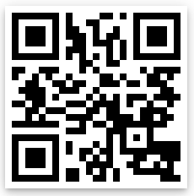
Mathematical connections and misconceptions
Averages
Each group will produce their own connections diagram on a different topic
You can find inspiration here:
Pie Charts
Sharing in a Ratio
bit.ly/ETFCfEM
(case sensitive)
Using Formulae
Compound Areas
Notes:
Topics chosen carefully to allow for the maths journey to be well-defined, along with a variety of misconceptions at different levels.
Each group of participants should be given a different topic to work on.

Slide 24

Active QR code to demonstrate what QR code links to
Notes:
PD lead to use if desired

Slide 25
Mathematical connections and misconceptions
CO-ORDINATES
Step 2 – Add misconceptions
Notes:
ACTIVITY STEP 2: What misconceptions do students make at various stages? This step is VITAL for activities which follow later.
PD lead to add to the earlier connections diagram, with ideas for misconceptions at various stages of working with co-ordinates.
During this kind of mapping, misconceptions can be highlighted so that they are not a surprise and can be planned for (and sometimes introduced explicitly for students to critique)
Participants then replicate this with their group’s topic.
Photographs of versions of the diagrams produced by PD Leads are available on the PD Lead Padlet.
Before the break, each table will present their diagram and talk through their thought processes (each table to choose one spokesperson).
The diagrams can then be displayed on a wall (sticky putty?) during break for the groups to read closer, and perhaps photograph if they would like a record.

Slide 26
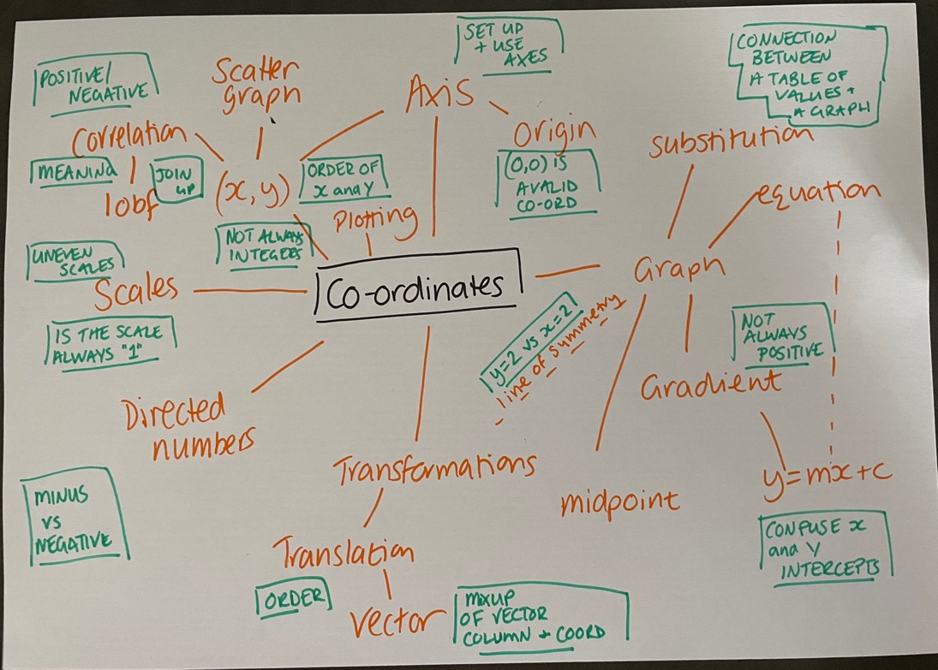
Notes:
HIDDEN SLIDE WITH EXAMPLE.
Not exhaustive! Orange = connections, Green = Misconceptions

Slide 27

Break

Slide 28
05
Questions and misconceptions
Notes:
Divider Slide

Slide 29
Responses from the Centres for Excellence in Maths
Formative Assessment
Building Confidence
Awareness
Timely
Flexibility
Learner focused
Misconceptions
Assessing usefully
Ongoing
usefully
Notes:
Version of earlier slide (not animated) – to refresh memory after coffee break.
This next section will explore how a selection of the Centres for Excellence in Maths have explored the concept of Responsive Teaching.

Slide 30

Research from centres
Can exam questions be used as effective diagnostic tools?
Notes:
Lucy from Wilberforce Sixth Form College has given us an insight into their research this year.
https://youtu.be/9z9BpD-n-Pg (click on sound icon on slide)
Main takeaway – using GCSE questions as diagnostics is efficient to see WHERE gaps in knowledge occur, but they do not highlight WHY they occur.
Wilberforce recognised that to highlight misconceptions a different approach was needed – they chose to look at “EEDI” and “DiagnosticQuestions.com” which have a bank of multiple choice questions.
The choices of answer are chosen carefully to show any misconceptions that a student may have (more on this later!)

Slide 31
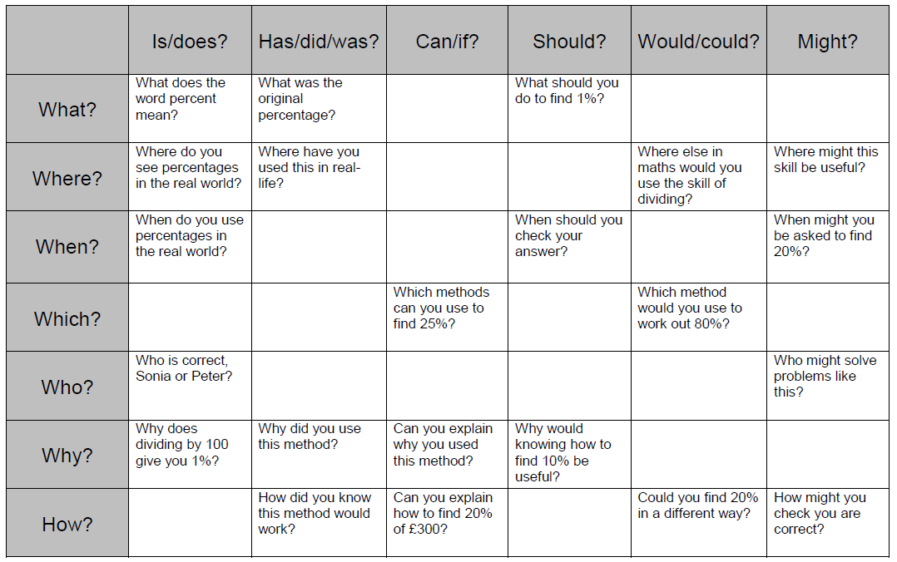
Research from centres
Notes:
Nelson and Colne College adapted a Questioning Matrix to aid teachers in their PRE-PLANNING of questions to tease out misconceptions. By using the sentence stems in the header row and column, questions can be framed at different levels to highlight misconceptions. Teachers can then adapt their teaching accordingly.
RESOURCE 2.5 HANDOUT

Slide 32
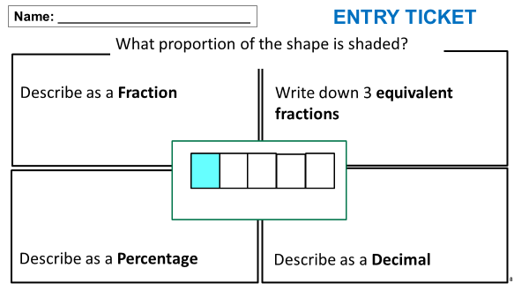


Research from centres
Notes:
https://youtu.be/4Djntj6ukYI (click on video image in bottom left to go straight to YouTube for video).
Shabana Raman from East Kent College Group explains their Entry (and exit) ticket approaches to identifying gaps and misconceptions.
Lovely analogy used by Shabana in the video about files being stored incorrectly.
Further quote from Shabana about the impact of responsive teaching in Functional Skills animates on click.

Slide 33
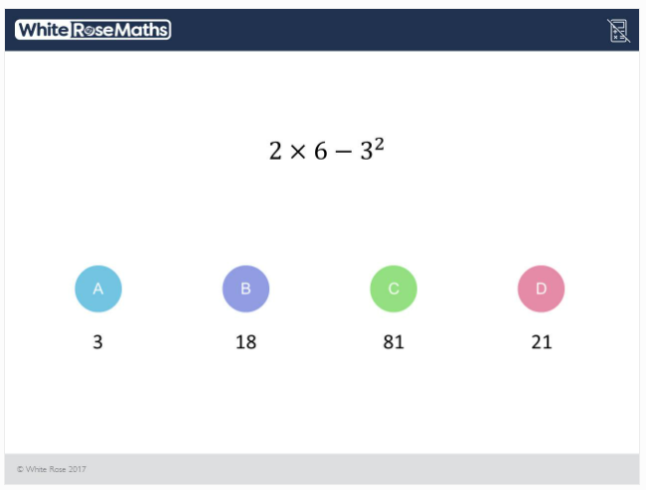
Research from centres
Notes:
Many centres have used Diagnostic Questions like this example to great effect.
ACTIVITY – answer this as though you are a Post-16 learner.
What mistakes could they make?
How are the responses designed to find misconceptions?
Insights provided by question author:
A We have 2 × 6 - 3² = 2 × 6 - 9 = 12 - 9 = 3.
B The student has squared (6-3).
C The student has squared at the end, rather than the beginning.
D The student has squared negative 3.
More DQs can be found by signing up (free) here: https://diagnosticquestions.com/
Authors of note: eedi, White Rose, AQA, Edexcel, OCR
There is also a link to DQs on the Module 2 Padlet.

Slide 34
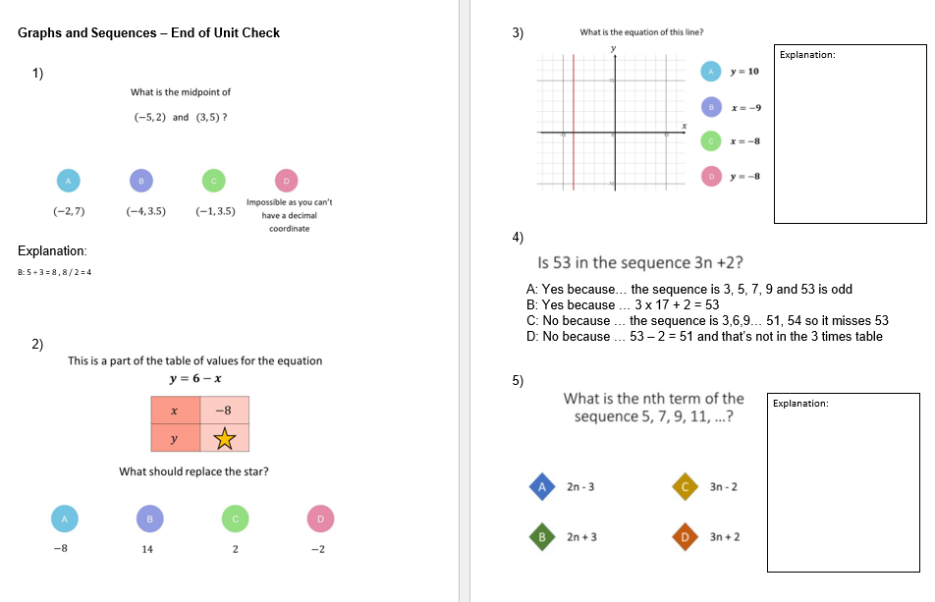
Research from centres
Notes:
Questions sourced from www.diagnosticquestions.com
RESOURCE 2.6 HANDOUT
PD Lead to talk through this case study which is illustrated by slides 34, 35 and 36:
Slide 34 Jane from Leyton Sixth Form College shared with us the checks they are using in their maths lessons – also using a multiple choice question approach. The slide shows an excerpt of a diagnostic assessment.
They used questions from “DiagnosticQuestions.com” and also wrote their own to ensure they were identifying the misconceptions linked to their Scheme of Learning and lesson structure. Students’ explanations of the choices they made are every bit as important as the choice itself. These help uncover misconceptions, and show that the answer is not just a guess.
Slide 35 zooms in on question one for participants to discuss. What misconceptions do the incorrect choices exemplify?
Slide 36 Leyton extended this process to include sample answers for students to critique.

Slide 35
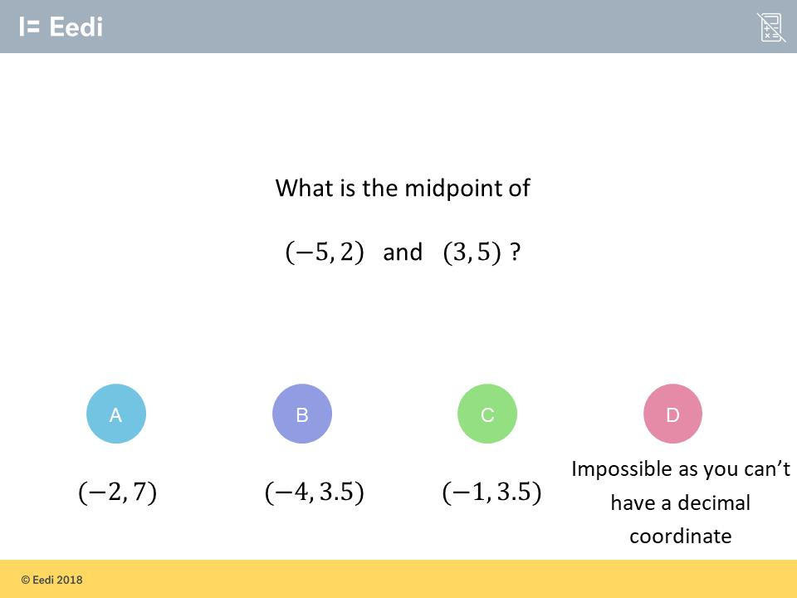
Research from centres
Notes:
Zooming in on this question – discuss the misconceptions. Link to the Co-ordinates diagram from Connections section
A – Added the x coordinates together and the y coordinates together
B – Incorrect negative number work
C – Correct answer
D – Fundamental misconception

Slide 36
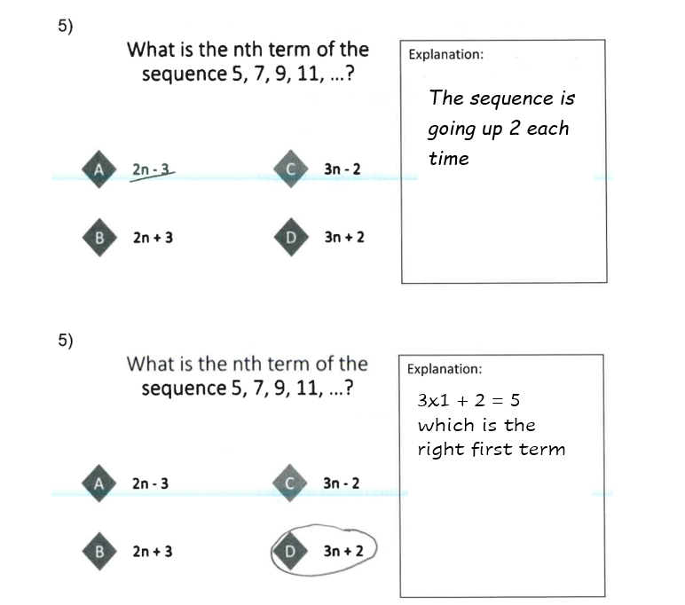

Research from centres
Learners asked to critique statements explaining methods
Notes:
Leyton also took the DQs a step further, asking the students to critique the reasons given for answers to multiple choice questions.
Talk through this with participants – what are the benefits here? More links and connections being made?
In Improving Learning in Mathematics (the blue box Standards Unit), Malcolm Swan encourages the working with Reasoning and Solutions as well as Evaluating Statements. These dovetail beautifully with Leyton’s work here.
RESOURCE 2.7 HANDOUT

Slide 37
06
Planning for questioning
Notes:
Divider Slide.

Slide 38
Planning for questioning
  Using the diagrams from earlier in the session, each group will design a question which diagnoses misconceptions within their ‘specialist’ topic
  You could design an entry/exit ticket, a DQ style question, or questions to ask orally
  You will present your question at the end of this section, asking other participants to answer them, highlighting the misconceptions tested.
Notes:
Participants will use their diagrams from the earlier activity to formulate a diagnostic question.
They should draw from all types discussed – entry/exit, multiple choice, oral, adapted exam qs AND any others that they think will work.
The questioning techniques covered in the previous section highlight misconceptions in such a way as to be able to show the students exactly WHY they are getting the concept incorrect.
This means that a teacher is enabling DELIBERATE RE-THINKING to help the student make new connections (whether as a whole class or an individual).
PD lead should circulate offering advice.
Each group will present their question/s to the cohort, inviting answers and discussion of the misconceptions tested.

Slide 39
Planning for questioning
Averages
Pie Charts
Sharing in a Ratio
Using Formulae
Compound Areas

Slide 40
07
Next steps
Notes:
Divider Slide

Slide 41
What changes will you make in your practice?
  Use the reflective log to review content of this module.
  Use what you have learned and discussed today to try Responsive Teaching in your classroom and reflect upon its impact.
  Use the questions, or new ones, to tease out misconceptions from your learners.
  Be ready to feedback next time.

Slide 42
Gap task 1
  Before attending module 3, work through the following question.
  What different approaches can you use to solve it?
Em, Finch and Gill build a wall each.
Altogether they use 60 blocks.
Finch’s wall is twice as long as Em’s wall.
Gill’s wall is three times as long as Em’s wall.
How many blocks are in each of their walls?

Slide 43
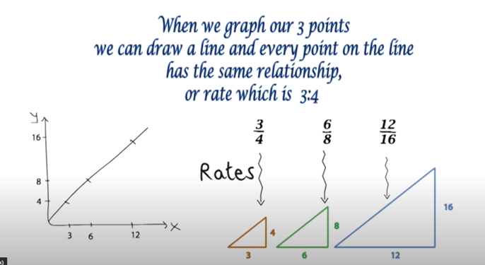
Gap task 2
Watch this video of Jo Boaler talking about ‘Mathematical Connections’:
https://www.youtube.com/watch?v=7FE_8wGgw_M
What are your thoughts about this video?
Make brief notes to discuss at the next session.

Slide 44

Further CfEM resources on responsive teaching
Responsive Teaching: an intervention for FE maths
CfEM action research reports (scroll to responsive teaching)

