Slide 1


Lesson 6:
Scales, maps and scale drawings
Level 2
Objectives
To be able to convert metric units of measurement
To be able to use a scale to find lengths
To be able to represent a proportional situation in a ratio table

Slide 2

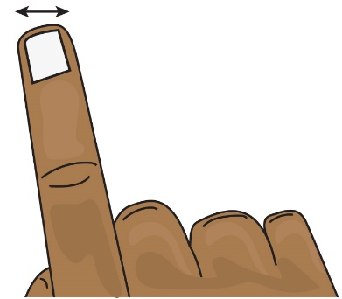
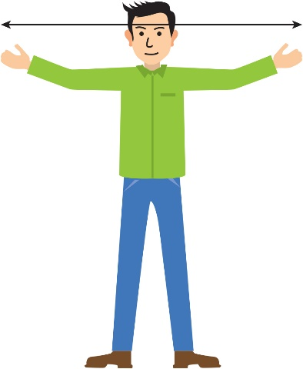
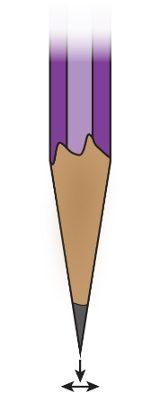

INTRODUCTION
Find the measurements
1 cm
10 mm
1 m
1 mm
1000 m
100 cm
1 km
Notes:
Learners to work in pairs to match the measurements and pictures.
Do they have a sense of how long each unit is?
When they complete the task, they should have all the metric conversions for length they will need in this lesson.
Answers:
Width of a finger: 1 cm
Arm span: 1 m
Pencil tip: 1 mm
Distance between two bridge pylons: 1 km

Slide 3
INTRODUCTION
Find the measurements
1 cm
10 mm
1 mm
1 m
1000 m
100 cm
1 km
Notes:
Tutor to ask for feedback from the class.
The learners may measure their finger using cms but some may have said mm. Talk about the conversion and that 10 mm is the same as 1 cm – tell them to look at their ruler.
They would probably measure arm width using metres – but could have used cm. Similarly, ask how many cm are in 1 m.
The bridge would be measured in km – but how many metres are in a km?
mm is the odd one out – we don’t normally measure in smaller units than mm.

Slide 4
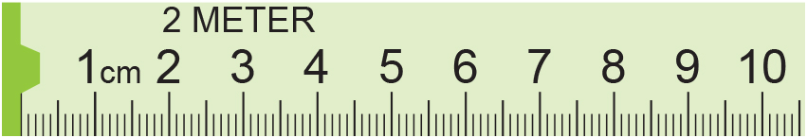
MODEL
Reading scales and converting metric units
3.9 cm
or 39 mm or 0.039 m
Convert this measurement to millimetres and to metres
Centimetres | 1
Millimetres | 10
0.039
Metres | 1
Centimetres | 100
×10
×10
3.9
÷100
÷100
39.0
3.9
Notes:
Ask what reading is shown by the arrow.
Animation then shows it as 3.9 cm and students are asked to convert this to mm and m. Allow a few minutes and ask students for their methods.
Teacher to explain that ratio tables are an effective method.

Slide 5
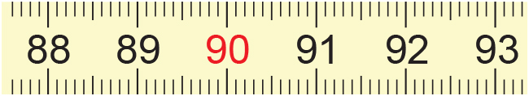
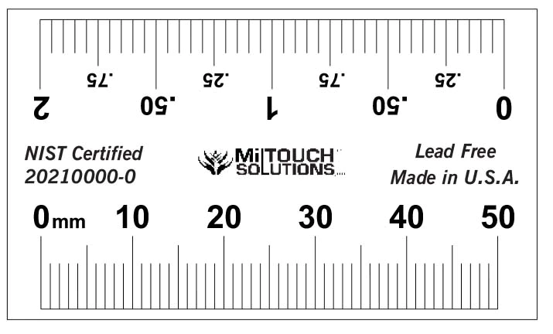
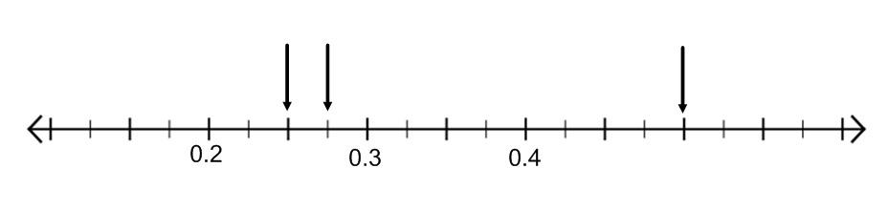
EXPLORE 1
Reading scales and converting metric units
1) Write these in cm, mm and m.
(a)
(b)
2) Write these in mm and cm.
(a)
(b)
(c)
(b)
(c)
(a)
3) Write these in m and cm.
m
Notes:
The worksheet has ratio tables pre-drawn to help learners organise their thinking.
The scale in Q3 is harder to read. How can learners help themselves to work this out?

Slide 6
Reading scales and converting metric units: answers
REVIEW
(a)
1) Write these in cm, mm and m.
89.3 cm, 893 mm, 0.893 m
91.0 cm, 910 mm, 0.91 m
(b)
2) Write these in mm and cm.
12 mm, 1.2 cm
24 mm, 2.4 cm
48 mm, 4.8 cm
(a)
(b)
(c)
3) Write these in m and cm.
(b)
(c)
(a)
0.5 m, 50 cm
0.25 m, 25 cm
0.275 m, 27.5 cm
m

Slide 7
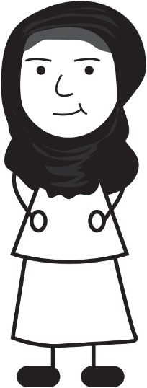
EXPLORE 1
Rahima’s mistake
Rahima is doing a metric conversion.
Rahima is not correct?
Can you explain why with a ratio table?
0.3 m is the same as 0.003 cm because
you divide by 100 to change from m to cm.
Notes:
Learners may give the answer that Rahima needs to multiply by 100 but can they explain why this is correct?
Diagrams such as ratio tables make this explanation very clear.

Slide 8
REVIEW
Rahima’s mistake: using ratio tables
cm
metres
100
10
30
1
0.1
0.3
So, 0.3 m is 30 cm.
Notes:
Using a ratio table to illustrate the conversion will allow learners to work well without a calculator and will underpin their understanding of converting between metric units.
Ask questions such as:
Would you use all of these steps?
What could you do differently?
This allows learners to really think about the relationship of the numbers with a simpler example before moving on to the more difficult tasks coming up.
A ratio table is used to illustrate approaches. It is important to reiterate that this is used for illustration of a range of approaches. Although the ratio table is provided, it is only intended to be used to capture learners’ thinking, not as a ‘method’. The ratio table does, however, suggest multiplicative approaches and is encouraged to be used, along with their own diagrams, if appropriate, to capture your learners’ thinking. What is important is that the learners understand what they, and their peers, have done.

Slide 9
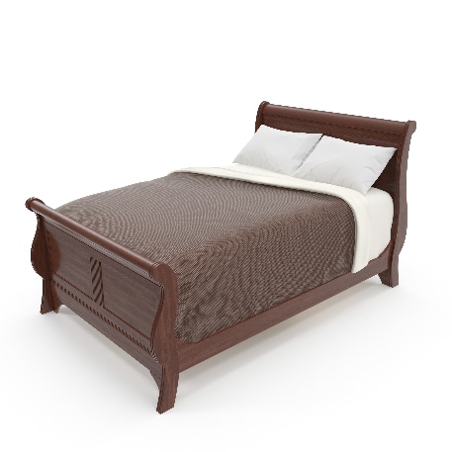
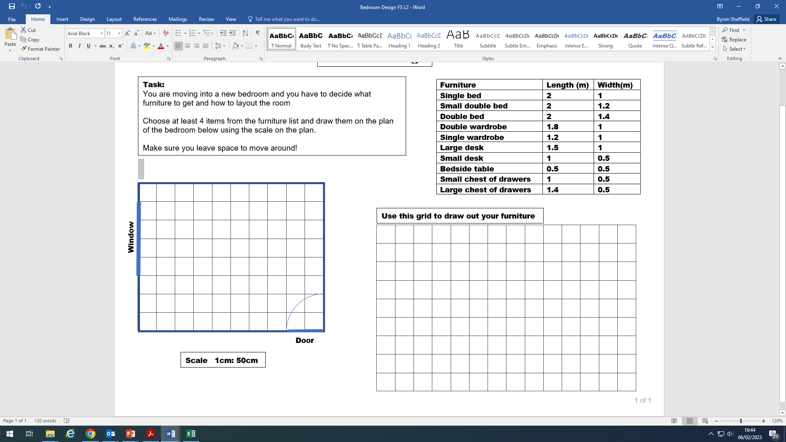
EXPLORE
Bedroom design
Ali has bought a new bed and is planning where to put it in his room. He has made a scale drawing of his room.
The scale is 1 cm : 50 cm.
Here is how he worked out the scale size of the bed:
1.4m
2m
×100
×100
2
×100
1.4
metres | 1
centimetres | 100
200
140
÷50
÷50
4
÷50
2.8
drawing (cm) | 1
real bed (cm) | 50
200
140
So now he draws a rectangle size 4 cm by 2.8 cm on centimetre squared paper.
Bed
Scale 1 cm : 50 cm
Where do you think he should put the bed in his room?
Notes:
Tutor to talk through the slide which has animations.
Introduce the next activity and show learners the scale drawing of the bedroom and the scale that has been used. A Realistic Mathematics Education approach has been used where not all dimensions fit exactly into the scale. Model how to do this with a ratio table, i.e. how to convert the units of the bed (metres) to the ones in the scale (centimetres) and then use the scale to find the measurements for the scale version of the bed. This is then shown on a grid so that learners can see its size and make suggestions as to where they think Ali should put the bed in the room. The example shown does not neatly fit into the scale as the bed works out as 2.8 cm in width. Look out for learners who do not know how to approximate this width using the 1 cm grid provided.

Slide 10
EXPLORE
Bedroom design
Ali’s sister has been given a plan of her room. It has a built-in wardrobe.
She is trying to work out the real size of the wardrobe.
The scale is 1 cm : 60 cm. What size is the wardrobe?
Here is how she worked out the size of the wardrobe:
plan (cm) | 1
wardrobe length (cm) | 60
×60
×60
7
420
plan (cm) | 1 | 2
wardrobe width (cm) | 60
×60
×60
120
Scale 1 cm : 60 cm
Notes:
Discuss the use of plans and models to enable us to work out the size of real-life objects.
Tutor to allow learners time to think about the scale and the size of the wardrobe on the plan and in real life. Animations then show how using the ratio table is an effective way of working out the dimensions.

Slide 11
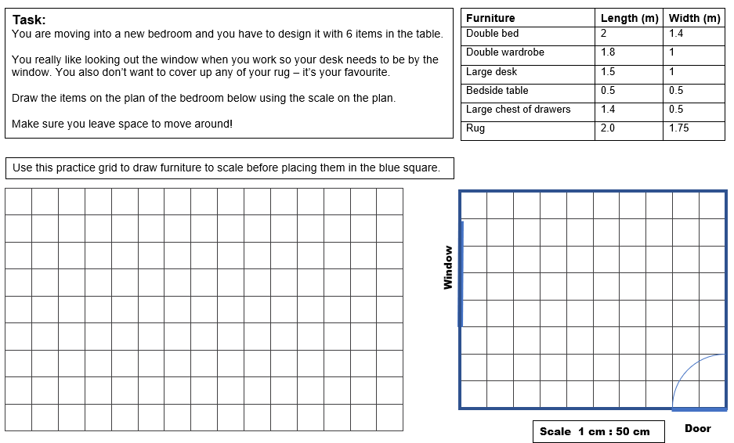
EXPLORE
Bedroom design
Notes:
Tutor to give out the worksheet and allow the learners to work through both tasks.

Slide 12
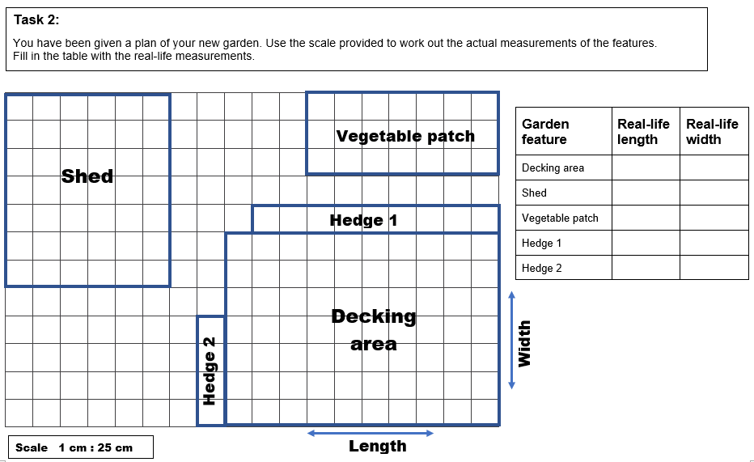
EXPLORE
Garden design
Notes:
Tutor to give out the worksheet and allow the learners to work through both tasks.

Slide 13
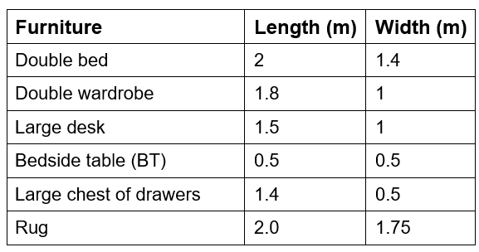
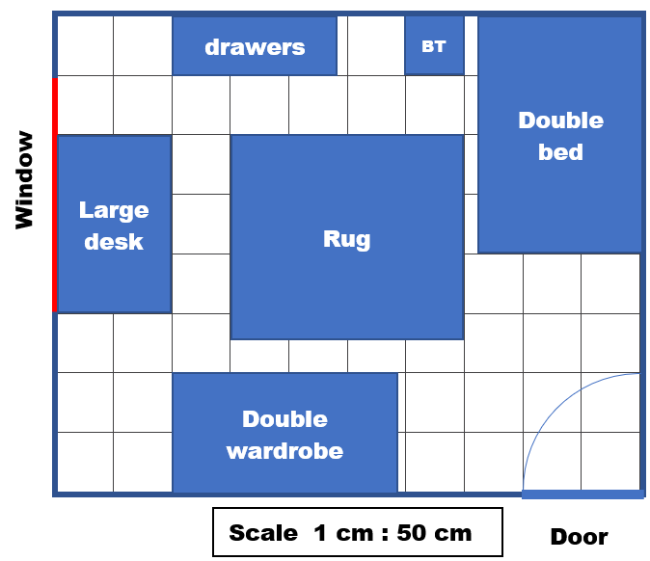
EXPLORE
Bedroom design – one possible solution
This illustrates one possible
design of the bedroom.
Other designs are also possible.
Notes:
Tutor to get feedback from class. Slide shows a possible solution. Points to look for: desk is at the window. You can move around the room. The rug is not covered at all. Practical things: bed side table by the bed. No furniture can be in the door opening area.

Slide 14
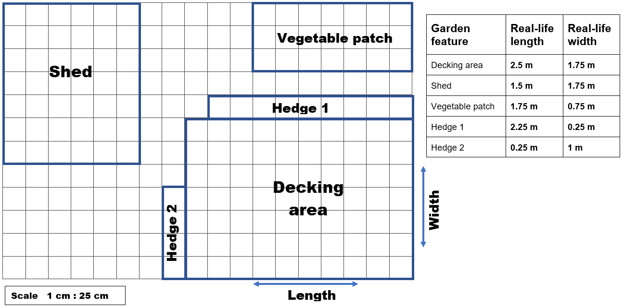
EXPLORE
Garden features – real-life sizes
Notes:
Tutor to get feedback from class and review answers, highlighting any misconceptions.

Slide 15
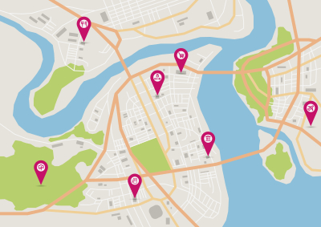
REVIEW
Maps and technology
Access an interactive map.
Can you see the scale?
What happens to the scale when you zoom in or out?
Pick two places on the map and use the scale to estimate the distance between them.
Notes:
Learners can access an interactive map on their phones or the tutor can demonstrate on the board.

Slide 16
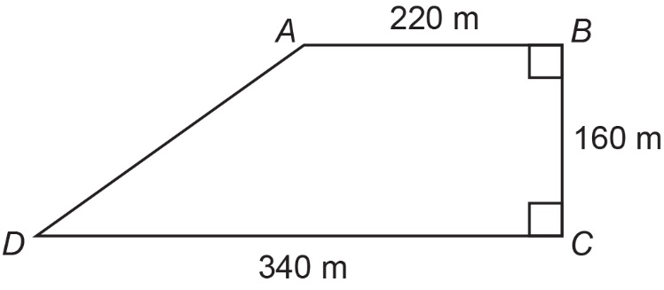
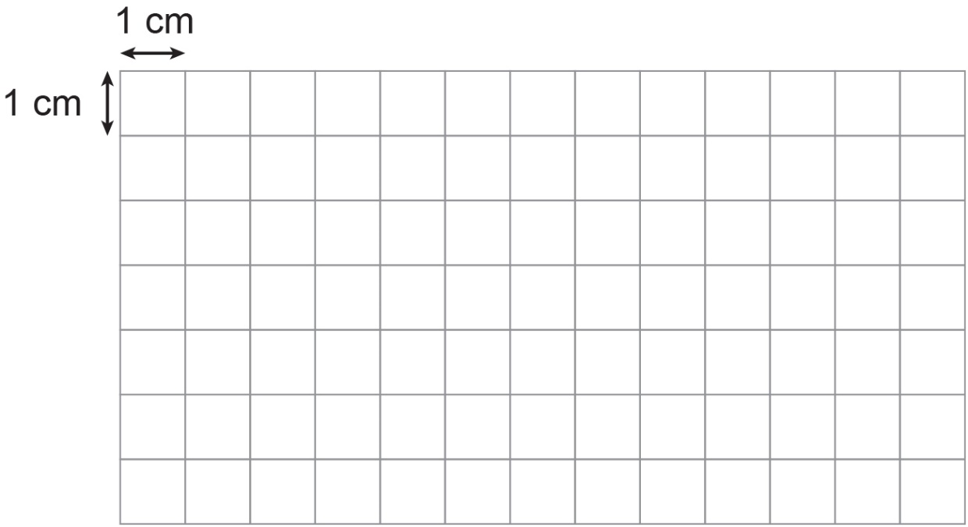
REVIEW
Exam question 1
Here is a quadrilateral.
Draw this shape on the grid.
Use the scale 1 cm to 40 m.
Use your answer to part (a) to work out the actual length of the line AD.
Remember to use the grid and the scale.
Notes:
Again, encourage learners to draw ratio tables to convince themselves they have got the answer correct.

Slide 17
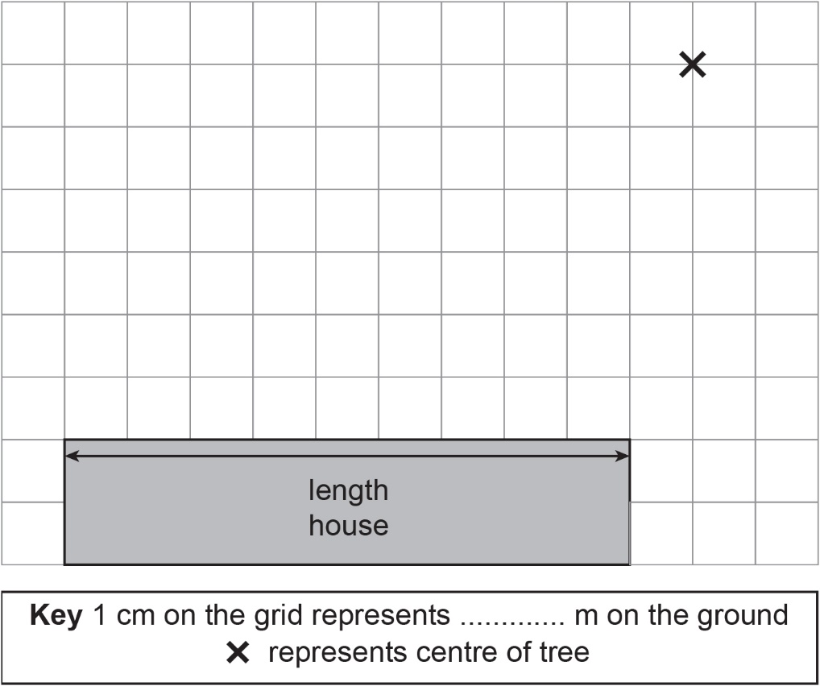
Exam question 2
REVIEW
Kasim wants an extension built onto his house.
The diagram shows part of the house and the centre of a tree.
The length of the house is 36 m.
Complete the key.
The extension will be in the shape of a rectangle with width of 10 m and the same length as the house.
The roots of the tree grow in a circular shape.
The roots grow to a maximum length of 20 m from the centre of the tree.
The extension will need deep foundations if built over the roots.
Will the extension need deep foundations?
Use the grid to show why you think this.
Notes:
Again encourage learners to draw ratio tables to convince themselves they have got the answer correct.

Slide 18
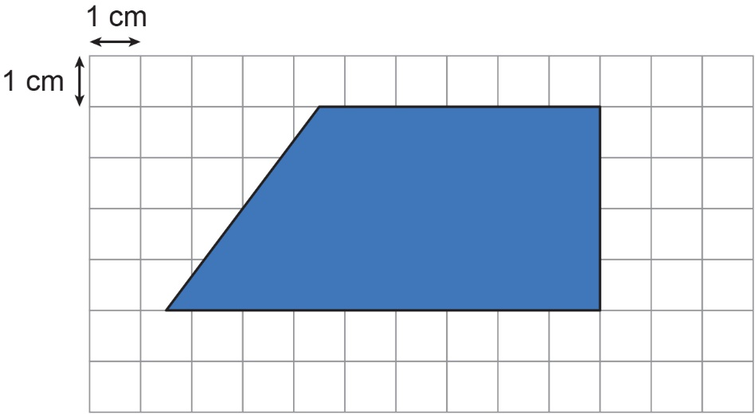
REVIEW
Exam question 1: answers
Draw this shape on the grid.
Use the scale 1 cm to 40 m.
Use your answer to part (a) to work out the actual length of the line AD.
Remember to use the grid and the scale.
Measuring, AD is 5 cm long.
200 m

Slide 19
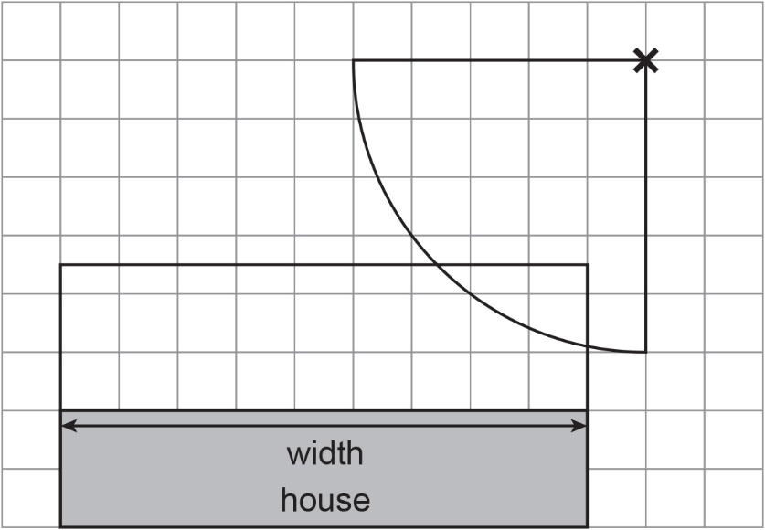
REVIEW
Exam question 2: answers
(a) Key: 1 cm on the grid represents 4 m on the ground
Extension overlaps with tree roots, so yes – the extension will need deep foundations.
(b)
Example solution

Slide 20
Lesson review:
Scales, maps and scale drawings Level 2
Objectives
To be able to convert metric units of measurement
To be able to use a scale to find lengths
To be able to represent a proportional situation in a ratio table
Suggested further steps/areas to work on
Converting between imperial units and metric units

Slide 21

Lesson 6:
Credits
Photo acknowledgements
Shutterstock.com: 3DMI, Luke Broughton, Maria Kazanova
Text Acknowledgements
Pearson Edexcel Functional Skills, Past Paper 1 - Mathematics Level 2 (Calculator) PMAT2/C01 Question 7, Pearson Edexcel Functional Skills, Past Paper 4 - Mathematics Level 2 (Calculator) PMAT2/C01 Question 6

