Slide 1
Teaching for Mastery in FE Maths
SLIDE TO BE UPDATED ACCORDINGLY THEN DELETE THESE BANNERS
Module 4 – Working with manipulatives
PRESENTER NAME
DATE AND TIME
SLIDE TO BE UPDATED ACCORDINGLY THEN DELETE THESE BANNERS

Slide 2
00
While you wait…

Slide 3
If you wish, while you are waiting, discuss your answers to some of these questions.
SLIDE TO BE UPDATED ACCORDINGLY THEN DELETE THESE BANNERS
The course is now half way through.
What activities from Modules 1-3 have you tried out?
What happened?
What will you do next?
Do you agree or disagree with John Holt? Share your reasons.
Learning is not the product of teaching. Learning is the product of the activity of learners.
(John Holt)
SLIDE TO BE UPDATED ACCORDINGLY THEN DELETE THESE BANNERS
Notes:
This task aims to encourage participants to talk about the impact that previous modules have had on them.
Suggestions of things to talk about are on the slide.
You may wish to take a couple of comments during the introduction, but don’t give more than a couple of minutes to this.

Slide 4
01
Gap task

Slide 5
Gap task between Modules 3 and 4
(Essential) Watch this video “What we’ve got wrong about learning mathematics” https://www.youtube.com/watch?v=-Gajs_UNItU
(Optional) – Simultaneous equations for reception children (minutes 13 to 17 approx.) https://www.youtube.com/watch?v=TvcM7GnY61U
Notes:
Teachers should have watched the TED talk, made a note of their responses to the questions on the next slide and brought their comments to the session to share.
The TED talk is mostly school-focused but much is relevant to FE.
The second optional clip is short but thought provoking and fits nicely in with what follows in this module.
Share reflections on tables for 5 minutes and feed back one thought from each table to the main group.

Slide 6
Gap task between Modules 3 and 4
As you watch, make a note of your responses to the questions below. The TED talk by Alf Coles is mostly schools focussed, but much is relevant to FE.
What surprised you?
What interests you?
What you agree with?
What you disagree with?
Anything else?
Bring your notes to Module 4 to share.

Slide 7
02
About this module

Slide 8
Welcome and introductions
SLIDE TO BE UPDATED ACCORDINGLY THEN DELETE THESE BANNERS
House-keeping, health/safety – populate with relevant info
Introductions – participants can could feed back some information from the ‘while you wait’ activity – adapt according to number of participants
Reminder - Reflective log
Reminder - Teaching for Mastery in FE Maths Padlet
SLIDE TO BE UPDATED ACCORDINGLY THEN DELETE THESE BANNERS
Notes:
Introductions- name and college, if needed. If desired, take comments on John Holt quote.
Reflective Log - (briefly) somewhere to make short notes about items they can take away and use.
Course Padlet - contains all module resources and also suggested further reading. Module 4 Padlet will be unlocked at the end of the module, or earlier if PD Lead wishes.

Slide 9
Reminder - Course structure
Module 1: Engagement and resilience
Module 2: Responsive teaching
Module 3: Making sense of proportion
Module 4: Working with manipulatives
Module 5: Getting "unstuck"- reasoning and problem solving
Module 6: Planning for learning
Notes:
Reminder of course structure

Slide 10
Aims
On completion of this module, participants will :
have an awareness of the research evidence which shows that making mathematical connections promotes learning.
be better informed on the use of practical approaches which improve students’ mathematical understanding and achievement.

Slide 11
Today’s schedule
SLIDE TO BE UPDATED ACCORDINGLY THEN DELETE THESE BANNERS
**:** Gap task
**:** About this module
**:** Thinking about connections
**:** Manipulatives and learning
**:** Using manipulatives to scaffold a tricky topic
**:** Making algebra meaningful…
**:** (Break – 15 mins after approximately 90 minutes)
**:** Multiple representations
**:** Next steps
**:** Close
PD Lead to replace asterisks with timings
SLIDE TO BE UPDATED ACCORDINGLY THEN DELETE THESE BANNERS
Notes:
Take a break a convenient point approximately half way through the session

Slide 12
03
Thinking about connections

Slide 13

Reminder – Module 3 gap task
https://www.youtube.com/watch?v=7FE_8wGgw_M
Notes:
Ask teachers briefly about the content of this video which they will have watched before Module 3.
If they can’t remember it, suggest that they watch it again!

Slide 14

A diagram mapping the connections in mathematics
There are several ways of connecting two concepts. The learner's way may not be the teacher's way. This is OK.
Can you think of any examples, from your own experience, where students have chosen an inefficient method which gives them the correct answer?
Notes:
Refer back to this image from Module 2 (Responsive teaching). Image from William Emeny, www.greatmathsteachingideas.com. Note that website has been taken down.
Remind teachers that mathematics is a network of ideas.
You may like to mention the Cambridge Mathematics project https://www.cambridgemaths.org/.
" We think mathematics learning 3-19 can be more connected and coherent and we are providing a structure to make this happen."

Slide 15
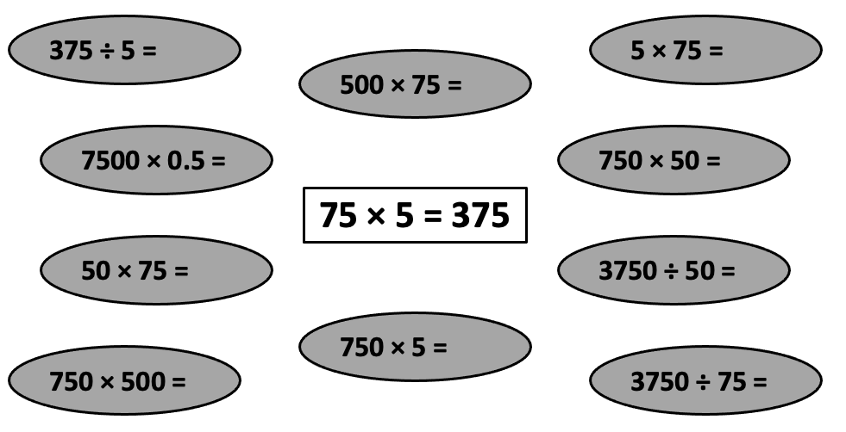
If I know this, then I also know…
Notes:
RESOURCE HANDOUT 4.4
This activity is based on a resource from the TES website and aims to exemplify mathematical connections.
Ask participants to briefly try out the activity, then discuss the connections it contains.
How could the activity be adapted to extend the number of connections, or to be used with other topics?
Possibilities:
have some empty boxes on the LHS
Include calculations of the form 75 = 375/5 and some of the form 75 = empty box/5.
Include fractions and/or percentages by changing the number format in individual spreadsheet cells.
The activity is posted as a customisable Excel file on the Module 4 Padlet.

Slide 16
04
Manipulatives and learning

Slide 17
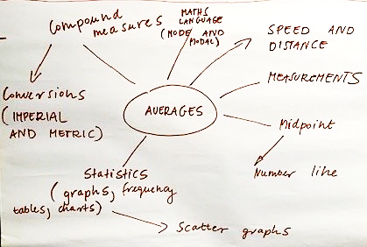
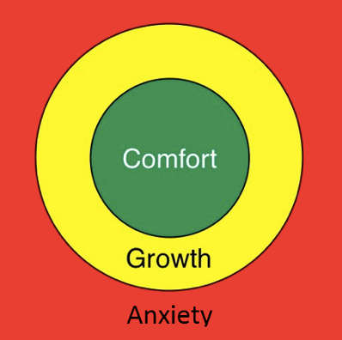
Lev Vygotsky 1896-1934
New learning is connected to existing learning, so existing learning must be secure.
Students learn best in the growth zone where they can connect new learning to old.
Notes:
Growth zone image from https://www.researchgate.net/figure/Growth-zone-model-Johnston-Wilder-et-al-2013_fig2_343882725
Bullet 1 – Point out that this idea is nearly 100 years old. Why is it not central to everything we do?
Unfortunately the myth that learning takes place when teachers “cover” curriculum content is not yet dead.
Make the link to Module 2 and the need for frequent formative assessment/assessment for learning so that teaching is responsive to learner need.
The diagram shows one example of connections to the topic of averages.
Bullet 2 – Make the link to Module 1, and the importance of students believing that they are capable of learning mathematics IF in the growth zone AND appropriately supported.

Slide 18
Jerome Bruner 1915-2016
In mid 1960s Bruner
coined the term "scaffolding" to describe a process in which the teacher provides carefully structured support.
suggested that students may experience, or "represent" tasks in three ways:
Concrete or enactive (action-based),
Pictorial or iconic (image-based),
Abstract or symbolic (language-based).
Notes:
Lots of different words here. No need to overcomplicate and remember them all.
Different people will be familiar with different words.
This slide is intended to make sure that participants have a common understanding of the language of CPA.

Slide 19
CPA in practice
Concrete - using objects to represent/model a concept or calculation. Could be any physical object e.g. Multilink/Unifix cubes, counters, cards or people.
Pictorial- using images to represent/model a concept or calculation. This might be a sketch summarising a situation, or images such as bar models or online objects in an app.
Abstract - being able to work with the concept or calculation using language, without the support of objects or images.
Notes:
Clarifying what CPA means in the classroom.
Students may develop mathematical understanding by working through representations from concrete to pictorial to abstract.
If they encounter a problem which they can’t tackle using abstract thinking, they can go back to pictorial or concrete representations to make sense of it.

Slide 20
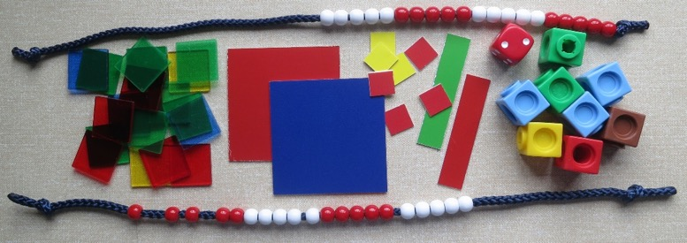
What are manipulatives?
Objects that students handle in order to explore an idea. They can be used to develop an understanding of new concepts or to disprove existing misconceptions.
Notes:
In the UK children start formal education younger than in many other countries.
Sometimes they are asked to think symbolically, and to use algorithms before they are ready to do so.
This sows the seeds of the oft heard “I can’t do maths”.
Make it clear that manipulatives are not just for young children.
They can be used to work with quite complex ideas, and can be used with students of any age to clarify the understanding of both simple and complex ideas.

Slide 21
Current use of manipulatives in FE maths teaching
Read all the instructions and check that you understand what you have to do BEFORE you start!
In your group of 4-6, write on a sticky note the name of one manipulative in use by group members.
Use tally marks to record on the sticky note the number of teachers in your group who have used this manipulative.
Repeat for other manipulatives used by group members.
Stick your group’s sticky notes on a sheet of flip chart paper. Write around each one the concepts/procedures this manipulative could be used to scaffold. Where you can, include several topics for each manipulative and show links between topics.
Each group in turn displays their flip chart and BRIEFLY outlines their findings.
Any surprises?
Notes:
PD Lead to initiate activity with an example of one way in which they have successfully used manipulatives. Finish the activity by emphasising that all these manipulatives are examples of CONCRETE representations.
Some possible examples:
Place value - arrow cards, money, Dienes blocks
Double sided counters - negative numbers, sequences
Algebra tiles - a lot of prep time needed by the teacher and class time by the learner, but there is research evidence that the impact justifies the time spent.
Paperfolding - fractions
Transparent small tiles area
String. Perimeter, circumference, demo of pi?
People maths - stats, types of number
Boxes of smarties - stats
Number line/ measuring tape
Possible barriers – don’t mention unless raised. CfEM providers have NOT found any of these an issue.
Anticipate time, money, behaviour, babyish, mess, creation and organisation of resources. Encourage participants to de-bunk any barriers which arise.

Slide 22
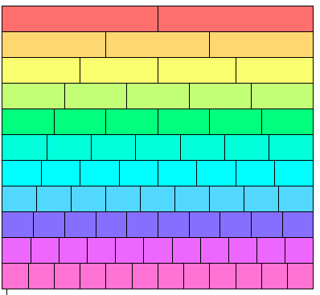
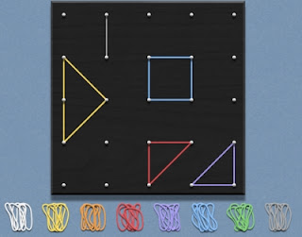
More examples of manipulatives
Fraction walls
Geoboards
This Photo by Unknown Author is licensed under CC BY-SA-NC
Notes:
Fraction wall – created as a Word table and printed on paper which can be cut up or folded.
File on Padlet. Can be used, cut into strips, as a concrete manipulative to model equivalent fractions, fraction addition, subtraction, multiplication and division.
Students can keep their fraction strips in a pencil case. Almost no cost.
Geoboards can be made by college carpentry students and used for work on shapes, area, transformations, types of number….

Slide 23
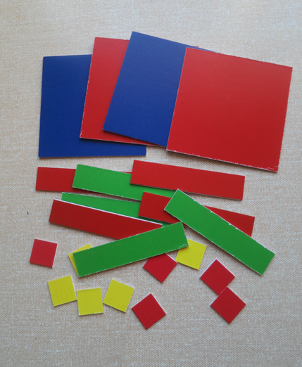
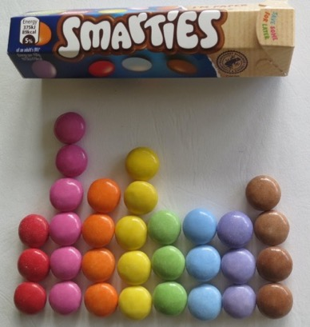
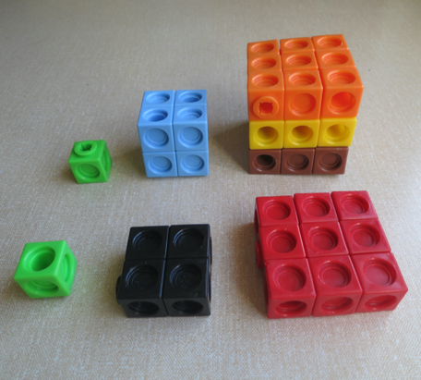
…and more
https://www.transum.org/software/Fun_Maths/People_Maths.asp
Notes:
Smartie bar chart. Potentially could do all of stats and probability from one box of Smarties.
Multilink showing square and cube numbers.
Algebra tiles
Members of the class can be used to model bar charts and averages, Venn diagrams and types of number. The only limitation is the imagination of the teacher.

Slide 24
05
Using manipulatives to scaffold a tricky topic

Slide 25
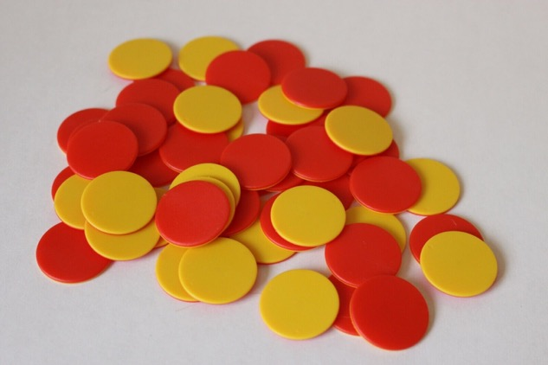
Exploring negative numbers
Double sided counters are helpful.
-
Notes:
Square algebra tiles could be used instead of round double sided counters.
Yellow for +1, red for -1.
Sample prices of round counters July 2022
50 for £3.99, 120 for £7, 200 for £10.15.

Slide 26
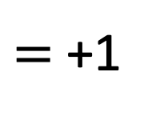
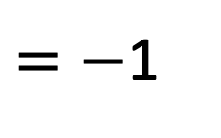
What number does this represent?
$=$+1
Why?
$=−$1
Notes:
Re-iterate the idea of a yellow counter representing +1 and a red counter representing -1. The number represented on this slide is 2.
Pause on the “why”, and ask for explanations. Some teachers may need time to understand that +1 -1 = 0.
They may need it modelled as “If I put one pound in your hand then I take it away, what have you got in your hand?” or “Starting at zero on a number line, jumping one jump in the positive direction and then one jump in the negative direction takes you back to zero.”
Neither of these explanations is ideal, as they blur the ideas of operations and directed numbers but they are an aid to explaining that together +1 and -1 have zero effect.
Take this slide, and the next, very slowly, asking individual participants to explain clearly what they are seeing after each animation (exemplifying effective classroom practice).

Slide 27
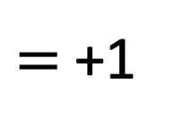
Zero pairs
$=$+1
$=−$1
Notes:
Each pair of +1 and -1 counters can be called a ZERO PAIR as together their value is zero.
Vital that all teachers are happy with this idea before you move on.

Slide 28
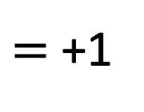
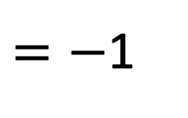
Represent the number 3
Using 3 counters
Using 5 counters
Using 9 counters
$=$+1
$=−$1
Notes:
Teachers work individually, checking each other’s answers and understanding and seeking support from each other as necessary. This models effective classroom practice.
Emphasise that, as mentioned in Module 1, students can offer help and support to each other, leaving the leacher free to observe and assess classroom learning , intervening only when necessary.
This activity checks teachers’ understanding of zero pairs.

Slide 29
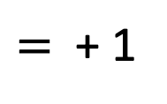
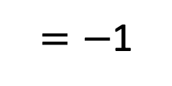
How many ways can the number 3 be represented using double sided counters?
$=$ + 1
$=−$1
Can you represent 3 using 8 counters? Explain your answer.
Notes:
Show this slide to reinforce the zero pair concept.
It may seem repetitive – pace the slide contents according to the reaction of participants
Use the three red counters to show that it is sometimes necessary to use positive numbers to make zero pairs.

Slide 30
Adding and subtracting directed numbers
+ and – are the signs for the operations of addition and subtraction
-4 and +4 are examples of directed numbers which can be can be written on a number line.
To avoid confusion when calculating, it is helpful to write directed numbers in brackets, especially if there are two adjacent signs.
Notes:
This is the cause of much confusion, misconception and inaccuracy.
Students and teachers need to be clear about the difference between the meaning of the + and – signs, depending where they are used. Operations are “add, plus” or “subtract , take away”. Directed numbers are “positive” or “negative”.

Slide 31
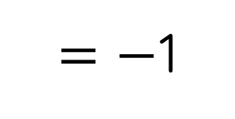
Using counters in calculations – an example
$=$ + 1
$=−$1
3 – (-2)
Start with three +1 counters.
Add two zero pairs because you need to subtract -2. At this point the counters still have a value of 3.
Take away -2, leaving an answer of +5.
Notes:
Use this slide to show how the counters are used in calculation.
Make sure you are confident in the use of counters yourself before sharing their use with teachers.
Once students are familiar with the use of counters, they can draw diagrams instead of using counters and can use this way of working in an exam.

Slide 32
Try to model these questions using your counters
$=$ + 1
$=−$1
4 + 2
4 – 3
4 – (+3)
4 - (-3)
-6 + 2
-4 – (-5)
If you are not feeling fully confident yet (!), spend some time after this module working with a colleague until you are.
Further reading : Adding and Subtracting Positive and Negative Numbers, https://nrich.maths.org/5947, from Counters Model onwards.
Notes:
Ask teachers to copy each question individually on to a miniwhiteboard and to arrange their counters below the question, supporting each other as necessary.
Some teachers may be teaching that brackets means multiply. It is better to teach that brackets in maths are like punctuation in English. They make the meaning clear for example 2 x 3 + 4 does not equal 2 x (3 +4).
Don’t rush this activity. For some teachers this will be new way of thinking and it is important that everyone understands the “zero pair” concept, even if they need more practice before using the concept in the classroom. Offer additional examples of questions like D and F if needed. But keep an eye on the time.
If participants are finding this challenging, emphasise the word “yet” to encourage the development of a growth mindset It is as important for teachers to have a growth mindset as students.
If you wish, you could model examples and solutions to the group as necessary using Mathsbot (https://mathsbot.com/manipulatives/twoColourCounters)

Slide 33
06
Making algebra meaningful with algebra tiles

Slide 34
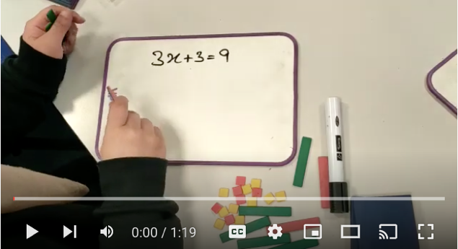
Why bother with algebra tiles?
Watch this learner, current level of achievement GCSE Grade 1, solving a linear equation.
https://www.youtube.com/watch?v=0xVrjUahJQI
Notes:
Make the point that we should not make assumptions about what students with the lowest grade can do. Everyone can progress if provided with support. This student has used concrete resources to support abstract thinking and clearly understands what she is doing.
Please click on the subtitle/cc button on the video to display the automatically generated subtitles during video playback.

Slide 35
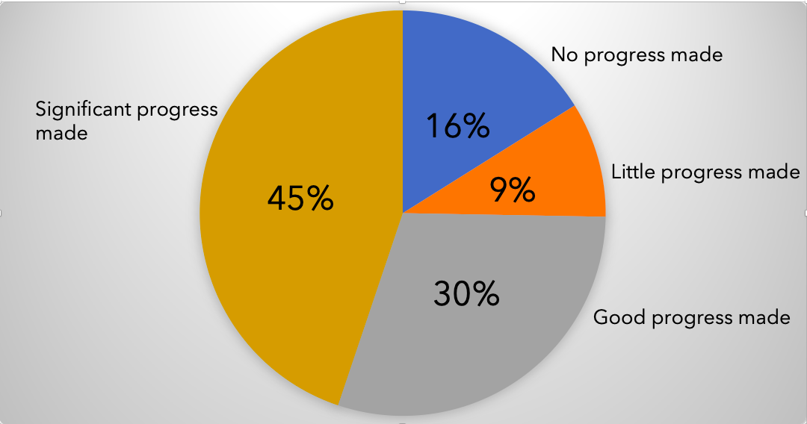
Impact of the use of algebra tiles in one college
Notes:
These numbers speak for themselves. Resit learners do not always make progress in algebra but it seems that using algebra tiles helps learners a lot.
Image from action research Warwickshire College group, https://www.youtube.com/watch?v=LprXsKQVcSo, 9 minutes into video

Slide 36
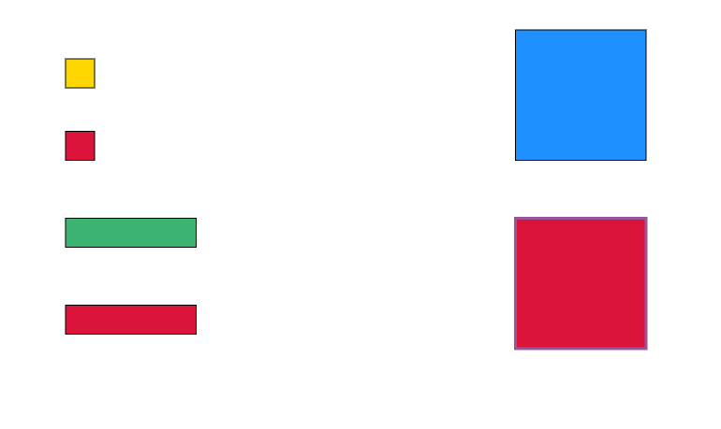
Moving on to algebra tiles
+1
+𝑥²
-1
+𝑥
- 𝑥²
-𝑥
https://mathsbot.com/manipulatives/tiles
Notes:
Note that all red tiles are negative. Tiles can represent variables as well as numbers.
Costs
Sample prices sets of algebra tiles July 2022
5 x x², 10 x x, 20 x 1 (plastic) £4.99
100 x x², 200 x x, 250 x 1 (cardboard) - £95

Slide 37
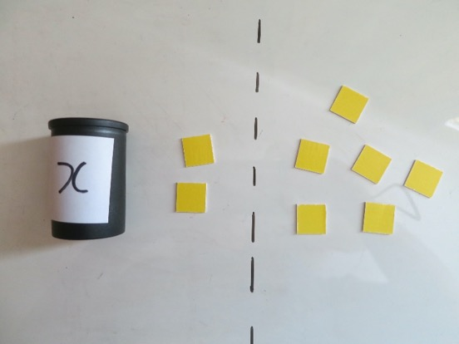
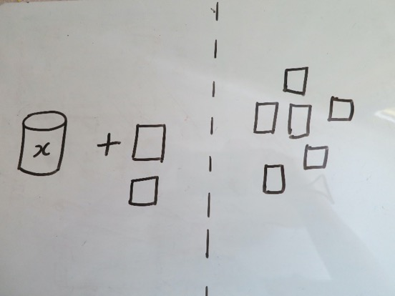
Exploring algebra – what is a variable? CPA in practice
Concrete – using practical materials – what’s in the box?
Pictorial – drawing an image
𝑥 + 2 = 6
Abstract – using mathematical symbols
Notes:
The number of counters on either side of the line are equal but some are hidden in a box called x. .
CPA approaches can help students to understand that a variable is a number whose value we don’t know, often named x or n.
It is well worth asking teachers to model this, and to consider asking their learners to model it in class.

Slide 38

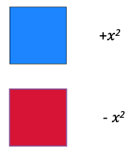

Create these expressions and equations using your tiles
1) 3𝑥 + 4
2) 2𝑥 - 3
3) 5 + (-2𝑥)
4) 𝑥² + 2𝑥 - 1
5) 4 - 𝑥
6) 2𝑥 + 3= 5
7) 𝑥² = 4
8) 3𝑥 – 1 = 5
9) 7 – 𝑥 = 3
10) 4 = 2𝑥 - 2
Notes:
This slide and next two slides adapted from a Leyton Sixth Form College resource.
Teachers to do some or all of these and check each other’s answers.
Model effective practice by asking teachers to select their own questions, at their chosen level of challenge.
PD leads to point out that everyone brings different prior knowledge to an activity and learns at a different speed but everyone can make progress and learn something new.

Slide 39

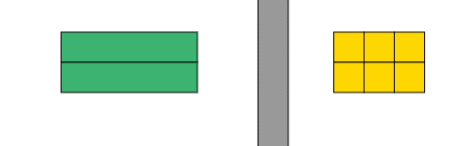
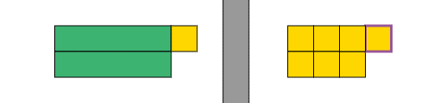
Building Up Equations – work in pairs
𝑥 = 3
This equation has been built up
in two stages.
×2
×2
Build up an equation using numbers of your choice and one of these starting values. Write the steps each time.
𝑥 = 2
𝑥 = 5
𝑥 = -3
4 = 𝑥
2𝑥 = 6
+1
+1
2𝑥 +1 = 7
Notes:
The purpose of this slide is to promote understanding of the STRUCTURE of an equation and how more complex equations can be built up from simple ones by doing same thing to both sides of an equal sign.

Slide 40
Taking equations apart (solving for x)
This two stage equation has been
broken down to find the starting
value of 𝑥.
2𝑥 +1 = 7
-1
-1
Break down these equations to find the original value of 𝑥.
Write the steps each time.
3𝑥 + 3 = 9
2𝑥 – 2 = 10
5𝑥 + 1 = 6
7 = 3𝑥 - 5
2𝑥 = 6
÷2
÷2
𝑥 = 3
Notes:
The purpose of this slide is to promote understanding of the STRUCTURE of an equation and how it can be taken apart to find the value of x by carrying out actions similar to the previous slide, in reverse order.

Slide 41
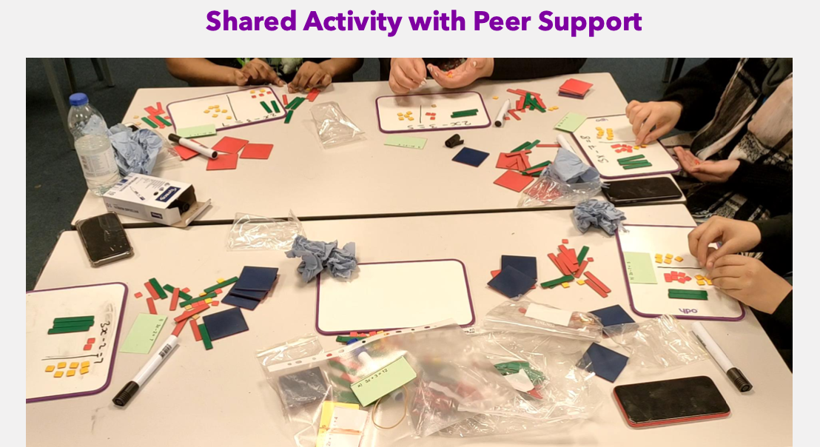
Notes:
This image shows an example of collaborative working in a CfEM college. Learners are solving linear equations using algebra tiles.
Notice the use of mini whiteboards. These enable tiles to be rearranged and errors to be removed without a permanent record being made, as would happen if an exercise book was being used.. This makes students more prepared to “have a go”.

Slide 42

Break

Slide 43

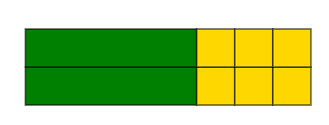
What else can we do with algebra tiles?
Expand 2(x+3)
= 2x + 6
𝑥
3
(𝑥 + 3)
Two lots of x + 3
2(𝑥 + 3)
2
Notes:
This slide and the following six slides based on a resource developed by Leyton Sixth Form College.
This is an example of using algebra tiles as an aid to factorising..

Slide 44
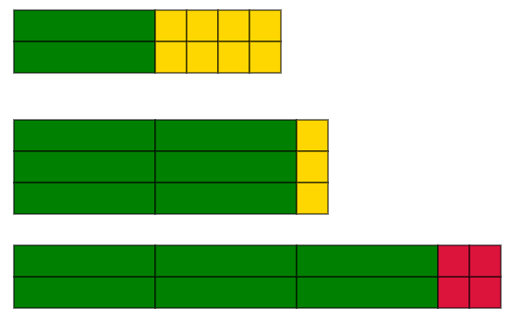

Now try these
Represent these expressions using algebra tiles, then write down the expanded form.
2(𝑥 + 4) = 2x + 8
3(2𝑥 + 1) = 6x + 3
2(3𝑥 – 2) = 6x – 4
x(2𝑥 - 1) = 2x² - x

Slide 45
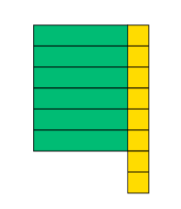
Factorising
All the answers to the ‘expanding brackets’ questions were rectangles. We can use this idea to think about factorising.
Factorise 6𝑥 + 8 by rearranging these pieces to make a perfect rectangle, with no gaps.
Notes:
Note: make sure that you have enough algebra tiles for teachers to model this.
Extra tiles could be made from card if necessary.

Slide 46

6𝑥 + 8 = 2(3𝑥 + 4)
Factorising 6x + 8 using algebra tiles
3𝑥
+4
2
Notes:
Rearranged tiles to show 6x + 8 when factorised.

Slide 47


Using an area model to factorise (pictorial representation) Factorise 6 + 2𝑥
= 2( 3 + 𝑥 )
3
𝑥
2
Notes:
If you feel it would be helpful, ask teachers to model and factorise this expression using algebra tiles before showing the area representation.
Emphasise the progression from working with concrete manipulatives to using a pictorial representation as their starting point. The concrete representation has scaffolded learning.

Slide 48
Using area models to expand brackets
Area models are quick to draw in an exam.
Questions to try by drawing an area diagram.
Expand 2(𝑥 +1)
Expand 3(𝑥 -2)
Expand 𝑥(𝑥 +1)
Further reading:
https://phet.colorado.edu/sims/html/area-model-algebra/latest/area-model-algebra_en.html

Slide 49
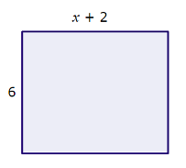
Using CPA representations to help to answer exam questions
Q1. Write an expression for the area.
Q2. If 𝑥 = 5, what is the area?
Q3. If the area is 30, what is 𝑥?
5
+ 2
𝑥
+ 2
𝑥
6
6 × 5
+12
6
18
+12
+ 2
6
6𝑥
+12
6 × 5 + 6 × 2 = 30 + 12 = 42
or
6 × 7 = 42
6𝑥 = 18
𝑥 = 3
6𝑥 + 12 or 6(𝑥 +2)

Slide 50
Finally…
Before you try any of this with your students, CfEM teachers recommend that:
you and your colleagues work collaboratively with the ideas until you are all confident in their use.
you don’t rush students – allow plenty of thinking time.

Slide 51
07
Multiple representations

Slide 52
Conceptual variation
Conceptual variation offers students several ways of looking at a given concept or algorithm.
This session explores activities which exemplify conceptual variation.
They give a student who doesn't know some of the underpinning ideas a sideways route into new concepts.
Notes:
CPA activities are often sequential, with understanding developed by progressively using more sophisticated models.
Multiple representations offer several ALTERNATIVE representations.
Students can choose the representation that makes most sense to them, and access the others through the one they chose first.

Slide 53
Exploring activities involving multiple representations
Teachers divide into groups of four. Each four splits into pairs (Pair 1 and Pair 2).
Pair 1 explores ILIM N1 Ordering fractions and decimals (20 mins)
Pair 2 explores ILIM A1 Interpreting algebraic expressions (20 mins).
Each pair then spends 10 minutes outlining the content of their resource to the other pair, addressing the following points.
What mathematical topics are encountered in the activity?
Outline the way in which the activity is designed to be used.
In what other ways could it be used?
What are the advantages of using this type of activity?
What might be the challenges of using this type of activity, and how might they be overcome?
Notes:
RESOURCE HANDOUTS 4.8 TO 4.11
Explain to participants that they are now going to explore activities where cards are the manipulatives, and this time there are several representations of the same mathematical ideas for learners to work with.
If time is short because previous activities have required more time, this activity can be given less time. The important thing is that teachers experience this type of activity and understand their value.

Slide 54
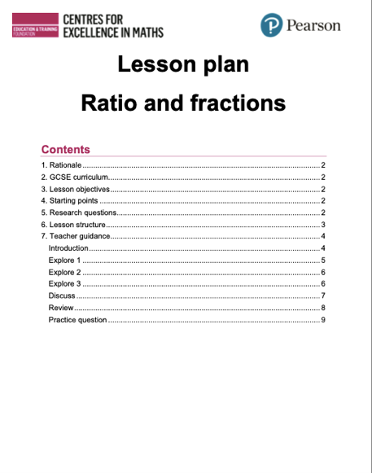
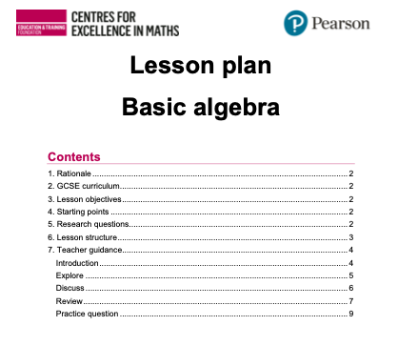
Other resources using these approaches
Research lesson: Ratio and fractions
Research lesson: Factorising and multiplying in algebra
Explore further research lessons and lessons designed by FE teachers on the CfEM classroom resources pages.
Notes:
These resources, and the ones teachers have just explored, have been extensively piloted in FE GCSE resit classrooms.
They work, so encourage teachers to give them a go.

Slide 55
08
Next steps

Slide 56
What changes will you make in your practice?
Use the Reflective log to review the content of this module.
Commit yourself to making one change to your teaching before attending the next module. Be specific. Exactly what will you change and when?
Share your thoughts on tables or with the whole group.
Notes:
Sharing a commitment to change one’s practice makes it more likely to happen.
PD Lead chooses how this is shared. - orally, privately, set up a WhatsApp group, other…..
Prompts might be
What will participants take away and try out/share with others?
What might they do differently at the beginning of the academic year?

Slide 57
Gap task between Modules 4 and 5
Watch this short video.
“Math class needs a makeover - Dan Meyer” https://www.youtube.com/watch?v=qocAoN4jNwc
As you watch, make a note of your responses to the questions below..
What surprised you?
What interests you?
What you agree with?
What you disagree with?
Anything else?
Bring your notes to Module 5 to share.

Slide 58
Further CfEM resources about using manipulatives
Action research reports:
Collaborative teacher working on using manipulatives | Report | Video
The role of CPA model in developing mathematical reasoning | Report
Can algebra tiles help FE maths resit students solve linear equations? | Report| Video
Using manipulatives to engage and motivate post-16 maths learners | Report | Video
To increase and deepen learners conceptual mathematical understanding by using sequences of concrete, pictorial and abstract representations delivered online through virtual manipulatives | Report | Video
Notes:
Reminder – show what is on Mod4 padlet

